Slide 1




Slide 2
Welcome to
Health Program Planning, Implementation, and Evaluation: Creating Behavioral, Environmental and Policy Change
Green, Gielen, Ottoson, Peterson, and Kreuter, eds: Health Program Planning, Implementation, and Evaluation
In this slide deck, you will find overall learning objectives followed by each chapter’s learning objectives, figures and tables, and student exercises.
Instructor Resources listed on the book’s website also include links to the following resources to support your use of this textbook:
  Syllabus Template
    Presents each chapter’s learning objectives and exercises
  Frequently Asked Questions (Appendix A of textbook)
    Based on years of teaching the PRECEDE/PROCEED model, here you will find answers to the most frequent student questions
  CEPH Competencies (Appendix B of textbook)
    Lists the Council on Education in Public Health competencies addressed by each chapter
  Health Behavior Change in Populations (Edited by Kahan S, Gielen AC, Fagan PJ, and Green LW, published by JH University Press, 2014)
    Complementary textbook with additional applications of theory to practice in health behavior change efforts across settings
Remember to check out LGREEN.NET (http://www.lgreen.net)
    This updated website contains more than 1600 published examples of the PRECEDE/PROCEED model as well as other helpful resources for instructors and students.

Slide 3
A Note on Copyright
Johns Hopkins University Press holds the copyright on the complete instructor’s resource slide deck.
Individual slides include sources of the material where relevant.
Government sources cited are in the public domain.

Slide 4
Overall Learning Objectives
Appreciate the importance of following a systematic approach to health program planning, implementation, and evaluation.
Utilize the PRECEDE/PROCEED Model for health program planning, implementation, and evaluation.
Apply the principles and methods of the PRECEDE/PROCEED Model to health programs such as in community, occupational, school, and healthcare settings.
Achieve selected competencies relevant to public health research and practice as defined by the Council on Education for Public Health.

Slide 5
Part I
Hallmarks of the PRECEDE-PROCEED Model
Green, Gielen, Ottoson, Peterson, and Kreuter, eds: Health Program Planning, Implementation, and Evaluation

Slide 6
CHAPTER 1
A Model for Population Health Planning, Implementation, and Evaluation
Green, Gielen, Ottoson, Peterson, and Kreuter, eds: Health Program Planning, Implementation, and Evaluation

Slide 7
Chapter 1 Learning Objectives
Explain three key perspectives on the PRECEDE-PROCEED model’s application in research and practice.
Describe the importance of combining evidence-based practice and practice-based evidence for health promotion program planning.
Explain the hallmarks of the PRECEDE-PROCEED model’s applications over the past five decades.

Slide 8
Figure 1.1
FIGURE 1.1. The North Karelia Project in Finland characterized its web of relationships as shown here, reflecting in part the relationships among organizations or sectors at the community level, in part the relationships among people whose behavior was affected by the program over a 25-year period, and in part the relationships among variables that needed to change to affect disease rates and health. Sources: Puska, P., Nissinen, A., Tuomilehto, J., Salonen, J.T., Koskela, K., McAlister, A., Kottke, T.E., Maccoby, N. and Far-quhar, J. (1985). The community-based strategy to prevent coronary heart disease: conclusions from the ten years of the North Karelia project. Annual Review of Public Health, 6, 147–93. https://doi.org/10.1146/annurev.pu.06.050185.001051. Modified figure with permission from the Annual Review of Public Health, Volume 6 © 1985 by Annual Reviews. http://www.annualreviews.org. See also Farquhar, J. & Green, L.W. (2015). Community intervention trials in high-income coun-tries. In Detels, R., Gulliford, M., Abdool Karim, Q., and Tan, C.C. (Eds.), Oxford Textbook of Public Health (6th ed., Vol. 2, pp. 516–27). Oxford University Press. https://doi.org/10.1093/med/9780199661756.003.0112

Slide 9
Figure 1.2
FIGURE 1.2. This generic representation of PRECEDE-PROCEED, with its phases of planning, implementation, and evaluation, also represents the underlying theoretical cause-and-effect relationships among the determinants of health and quality of life for populations.

Slide 10
Figure 1.3
FIGURE 1.3.Compiled from multiple studies, the estimates of percentages of premature deaths attributable to the major determinants of health include 40% to behavioral patterns, 30% to genetic predisposition, and 30% to environmental factors. The last includes 5% to exposures in the physical environment, 10% to shortfalls in medical care, and 15% to social factors. Sources: Data updated in Johnson, N.B., Hayes, L.D., Brown, K., Hoo, E.C., Ethier, K.A., & Centers for Disease Control and Prevention (CDC). (2014). CDC National Health Report: leading causes of morbidity and mortality and associated behavioral risk and protective factors—United States, 2005-2013. MMWR Supplements, 63(4), 3–27. https://www.cdc.gov/mmwr/preview/mmwrhtml/su6304a2.htm. From McGinnis, J.M., & Foege, W.H. (1993). Actual causes of death in the United States. JAMA, 270(18), 2207–12. https://doi.org/10.1001/jama.1993.03510180077038; and Mokdad, A.H., Marks, J.S., Stroup, D.F., & Gerberding, J.L. (2004). Actual causes of death in the United States, 2000. JAMA, 291(10), 1238–45. https://doi.org/10.1001/jama.291.10.1238. Erratum in: (2005), JAMA, 293(3), 293–4. https://doi.org/10.1001/jama.293.3.293

Slide 11
Figure 1.4
FIGURE 1.4. Phases 3 and 4 of PRECEDE address the strategies and resources required to influence the predisposing, enabling, and reinforcing factors, which, in turn, influence or support behavioral and environmental changes. Changes in these targets become the explanations for program success or failure.

Slide 12
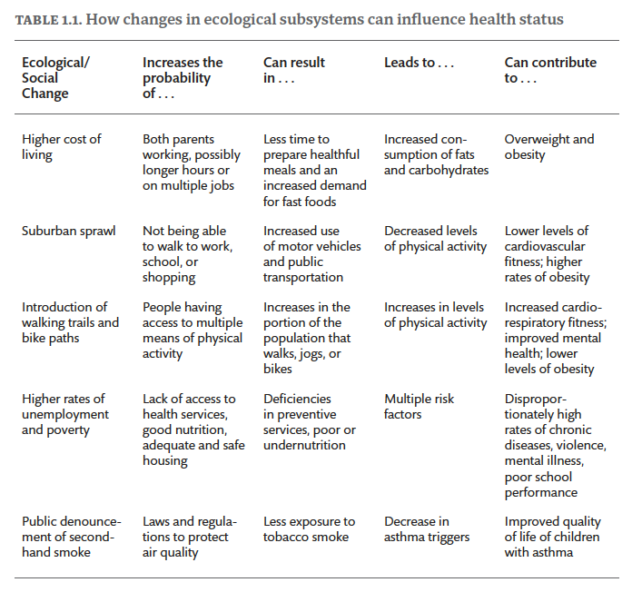

Slide 13
Chapter 1 Exercises
What trends have you noticed in recent years, in your community or among your friends, in health behaviors, conditions of living, and health concerns? Can you find any objective data to support your observations? If not, how would you go about verifying your personal view of these trends?
Identify at least three national or international health campaigns or programs spanning several years. How do you account for the public concern about these different health problems at different times? What were the major features of these programs? Why have different problems at different times required different health program methods?
Identify and describe the demographic characteristics (geographic location, size, age and sex distribution, etc.) of a population (students, patients, workers, or residents) whose quality of life you would like to improve. Follow the population you choose through most of the remaining exercises in this book. Look ahead at the upcoming exercises and make sure the population you choose is appropriate for the assessment and planning steps that will be required. If not, adjust accordingly and retrace your steps. (After all, adaptation and flexibility are encouraged in applying the PRECEDE-PROCEED model!)

Slide 14
CHAPTER 2
Participation and Community Engagement in Planning
Green, Gielen, Ottoson, Peterson, and Kreuter, eds: Health Program Planning, Implementation, and Evaluation

Slide 15
Chapter 2 Learning Objectives
Describe why effective community program planning requires the active engagement of residents, community leaders and public and private partners at the most local level.
Choose planning strategies that accommodate the diversity of values and needs within the specific population(s) of interest.
Explain why community members are more likely to participate in community public health efforts when they understand what you (and your collaborators) can and cannot do (or do well without their guidance and acceptance).

Slide 16
Figure 2.1
FIGURE 2.1. Social Ecological Model for Understanding Factors that Shape Fruit and Vegetable Access and Intake. Sources: Adapted from Rimer, B., & Glanz, K. (2005). Theory at a Glance: A Guide for Health Promotion Practice. US Department of Health and Human Services, National Institute of Health, and National Cancer Institute. Available from https://cancercontrol.cancer.gov/brp/research/theoriesproject/theory.pdf. See also: Institute of Medicine. (2003). Who Will Keep the Public Healthy?: Educating Public Health Professionals for the 21st Century. National Academies Press. For more information, see https://www.healthypeople.gov/2020/law-and-health-policy.

Slide 17
Figure 2.2
FIGURE 2.2. The relationships between health and social conditions are reciprocal.

Slide 18
Figure 2.3
FIGURE 2.3. Professionals view health through a different set of lenses than do people viewing their own health or that of their community. The professional lenses have a greater acuity (represented by darker arrows) at the “objective” end of the spectrum of health and a less clear view of the “subjective” end of the spectrum (represented by lighter arrows). The public lenses are the opposite, with greater acuity at the “subjective” aspects of health and less clarity at the “objective” end of the health spectrum.

Slide 19
Figure 2.4
FIGURE 2.4. Finding common ground among the public’s perception of needs, the health sector’s measurements of needs, and policy makers’ perception of resources and feasibility of meeting needs.

Slide 20
Figure 2.5
FIGURE 2.5. Bringing the three world views into closer alignment through public health education, participatory research, media advocacy, epidemiology, health services research, and community mobilization of resources enlarges the potential area for common action (A).

Slide 21
Figure 2.6
FIGURE 2.6. An ideal sequence of steps in a system and process of community social assessment and health planning, leading to official agency or centralized support, intersectoral cooperation, a cycle of continuous capacity building in the community (Steps 7–10), and ultimately greater self-reliance. Source: Adapted from Green, L.W. (1983). New Policies in Education for Health. World Health, xiii(6), 13–17.

Slide 22
Chapter 2 Exercises
Using the population you selected at the end of chapter 1, what types of questions would you want to pose to community members about the health issues that concern them? How closely would you expect these to align with official agency determinations of community needs?
What are methods you would consider for gaining the insights of your community members?
What types of partners could you rely on to serve as trusted intermediaries to your community, if you do not already have those relationships yourself?

Slide 23
Part II
PRECEDE-PROCEED Phases: Planning, Implementation, and Evaluation
Green, Gielen, Ottoson, Peterson, and Kreuter, eds: Health Program Planning, Implementation, and Evaluation

Slide 24
CHAPTER 3
Social Assessment: Quality of life
Green, Gielen, Ottoson, Peterson, and Kreuter, eds: Health Program Planning, Implementation, and Evaluation

Slide 25
Chapter 3 Learning Objectives
Explain why quality-of-life concerns should be part of health program planning.
Describe at least three ways to measure quality of life in a community.
Identify at least two limitations on your ability to measure quality of life in a community.

Slide 26
Figure 3.1
FIGURE 3.1. The first phase of the PRECEDE-PROCEED model, social assessment, focuses on the population’s quality of life relative to health and other factors.

Slide 27
Figure 3.2
FIGURE 3.2. This more detailed representation of the outcomes of the PRECEDE-PROCEED model (Phases 1 and 2) shows examples of the relationships, indicators, and dimensions of factors that might be identified in a PRECEDE diagnostic assessment and the outcome evaluation phases.

Slide 28
Figure 3.3
FIGURE 3.3. The National Civic League has identified seven key components of civic capital. For more on these components and a tool for community assessment around the components, see http://www.nationalcivicleague.org.

Slide 29
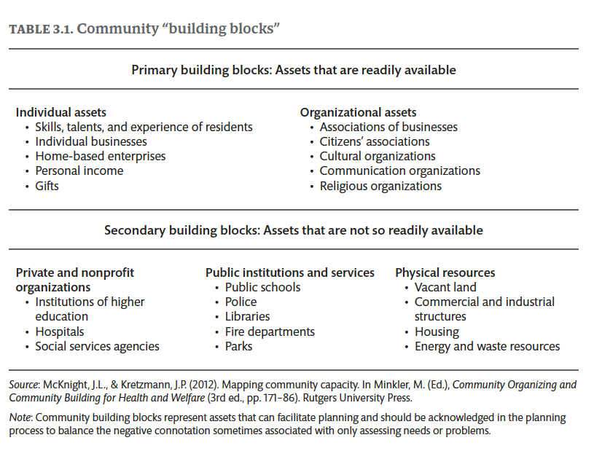

Slide 30
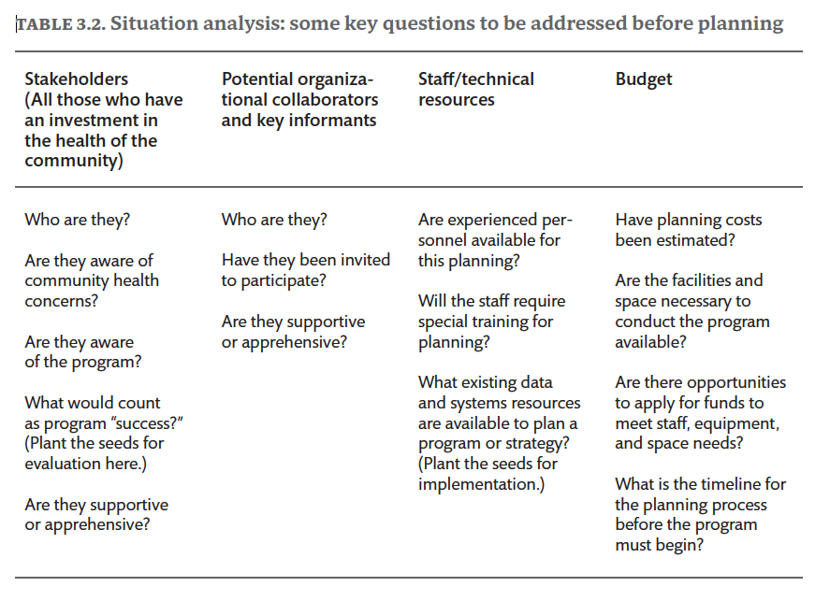

Slide 31
Chapter 3 Exercises
We suggest that these exercises be carried out on a real population accessible to the student or practitioner, in consultation with members of that population and service providers in that community. If this is not possible, the exercises can be applied to a more distant population using published census data, vital statistics, and data from surveys and other online sources to construct a hypothetical case example.
List three ways you would or could (or did) involve the members of the population you selected in exercise 3 of chapter 2 in identifying their quality-of-life concerns and their resources or assets for addressing them. Justify your methods in terms of their feasibility and appropriateness for the population you are trying to help.
How did (or would) you verify the subjective data gathered in exercise 1 with objective data on social problems or quality-of-life concerns, and on assets or resources?
Display and discuss your real or hypothetical data as a quality-of-life diagnosis, justifying your selection of social, economic, and health problems to become the highest priority for a new program.

Slide 32
CHAPTER 4
Epidemiological Assessment I: Population health
Green, Gielen, Ottoson, Peterson, and Kreuter, eds: Health Program Planning, Implementation, and Evaluation

Slide 33
Chapter 4 Learning Objectives
Understand the population health components of an epidemiological assessment.
Describe epidemiology concepts of prevalence, incidence, and adjusted rates.
Use these and other problem indicators to create program objectives.

Slide 34
Figure 4.1
FIGURE 4.1. The second phase of the PRECEDE-PROCEED model, epidemiological assessment, begins with a focus on the incidence, prevalence, and distribution of health conditions.

Slide 35
Figure 4.2
FIGURE 4.2. The examples here of health, lifestyle, and environmental factors interacting with poverty in reciprocal relationships support an ecological approach to assessment that cannot be rigidly linear or unidirectional in addressing causes and effects.

Slide 36
Figure 4.3
Trends in Obesity Rates for Youth and Adults
FIGURE 4.3. The chart shows a significant increasing linear trend from 1999–2000 through 2015–2016. Note: All estimates for adults are age-adjusted by the direct method to the 2000 US census population using the age groups 20–39, 40–59, and 60 and over. Source: NCHS, National Health and Nutrition Examination
Survey, 1999–2016. Accessible from https://www.cdc.gov/nchs/nhanes/index.htm.

Slide 37
Figure 4.4
FIGURE 4.4. The top 12 most common cancer sites will account for more than three-quarters of all new cancer cases (Incidence). Source: National Institutes of Health (NCI) (2020). Cancer Stat Facts: Common Cancer Sites. https://seer.cancer.gov/statfacts/html/common.html

Slide 38
Figure 4.5
FIGURE 4.5. The eight deadliest cancer sites will account for almost two-thirds of all expected cancer deaths (Mortality). Source: National Institutes of Health (NCI) (2020). Cancer Stat Facts: Common Cancer Sites. https://seer.cancer.gov/statfacts/html/common.html

Slide 39
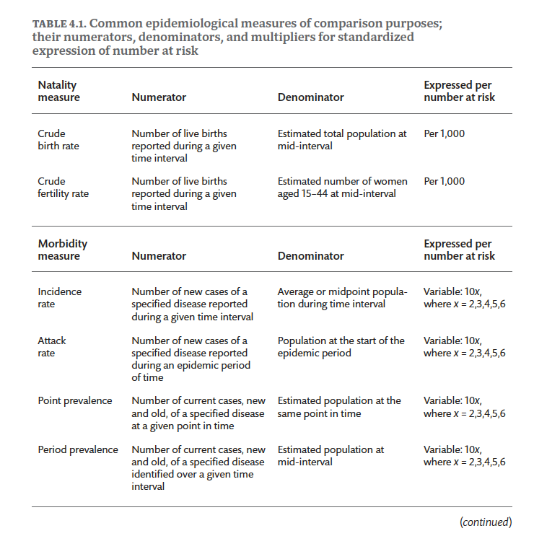

Slide 40
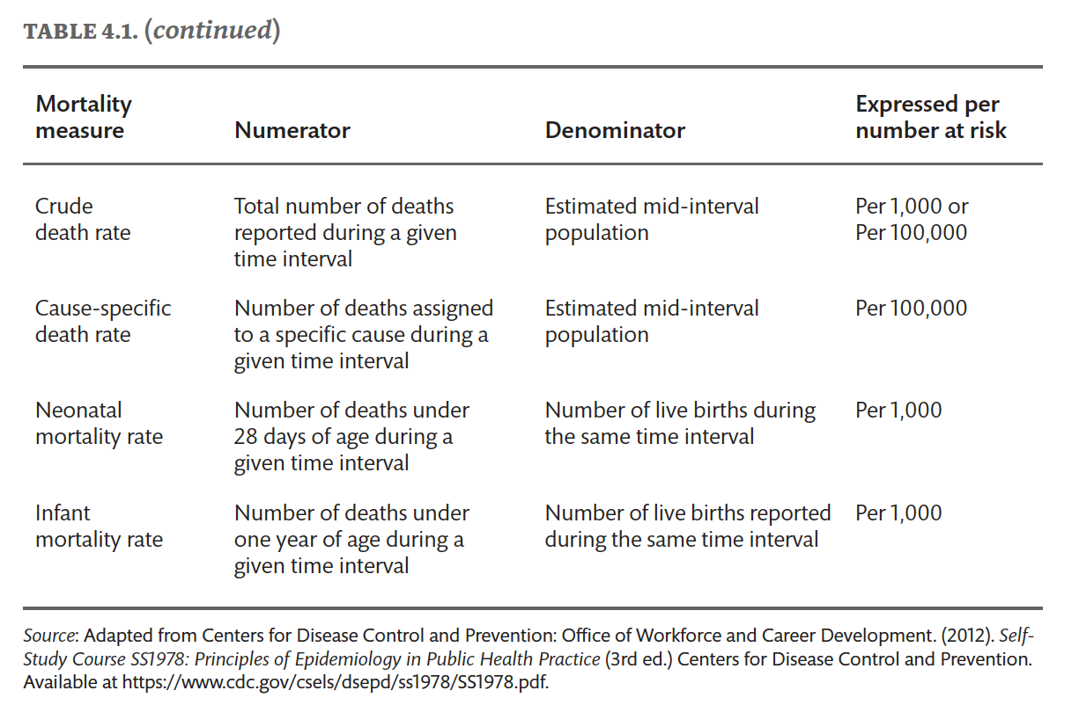

Slide 41
Chapter 4 Exercises
1. List the health problems related to the quality-of-life concerns identified in your population in exercise 3 of chapter 3.
2. Rate (low, medium, high) each health problem in the inventory according to
  2a) its relative importance in affecting the quality-of-life concerns, and
  2b) its potential for change.
3. Discuss the reasons for giving high-priority ratings to health problems in exercise 2a in terms of their prevalence, incidence, cost, virulence, severity, or other relevant dimensions. Extrapolate from national, state, or regional data when local data are not available. Cite the evidence supporting your ratings of health problems in exercise 2b. Refer to the success of other programs and/or to the availability of medical or other technology to control or reduce the high-priority health problems you have selected.
4. Cite two uses for data generated by epidemiological assessments other than for program planning, and give an example of each.
5. Write a program objective for the highest-priority health problem, indicating who will achieve how much of what benefit by when.

Slide 42
CHAPTER 5
Epidemiological Assessment II: Behavioral and Environmental Factors
Green, Gielen, Ottoson, Peterson, and Kreuter, eds: Health Program Planning, Implementation, and Evaluation

Slide 43
Chapter 5 Learning Objectives
Understand three interactive levels of influence on health that move from the more proximal to distal and that can be affected by population health programs and policy interventions.
Recognize the interventions and influential elements of at least two great public health success stories, as exemplified in tobacco control and injury control experiences.
Understand the four steps of a community behavioral assessment for at least two contrasting health-risk factors.

Slide 44
Figure 5.1
FIGURE 5.1. The second phase of the PRECEDE-PROCEED model continues the epidemiological assessment with a focus on the population’s health relative to behavior, the environment, and genetics.

Slide 45
Figure 5.2
FIGURE 5.2. Lung cancer rates for the San Francisco area increasing before 1988 and decreasing after the beginning of the California statewide voter Initiative on Comprehensive Tobacco Control. Source: Barnoya, J., & Glanz, S. (2004). Association of the California Tobacco Control program with declines in lung cancer incidence.
Cancer Causes and Control, 15(7), 689–95. https://doi.org/10.1023/B:CACO.0000036187.13805.30

Slide 46
Figure 5.3
FIGURE 5.3. A systems view of the behavior of keeping appointments can be delineated as a broken appointment cycle with a sequence of actions and reactions, decisions and choices, branching toward or away from further broken appointments.

Slide 47
Figure 5.4
FIGURE 5.4. The rankings of behaviors on the two dimensions of importance and changeability leads to at least four categories of possible action.

Slide 48
Figure 5.5
FIGURE 5.5. Influence on the population’s health. Source: Centers for Disease Control and Prevention. (2002). Shaping a Health Statistics Vision for the 21st Century. Department of Health and Human Services, National Center for Health Statistics.

Slide 49
Figure 5.6
FIGURE 5.6. The Environmental Protection Agency’s framework for ecological risk assessment was adapted by the Commission on Risk Assessment and Risk Management for the US Congress to include the particular points at which public consultation or community “stakeholders” would be most important.
Source: EPA.gov

Slide 50
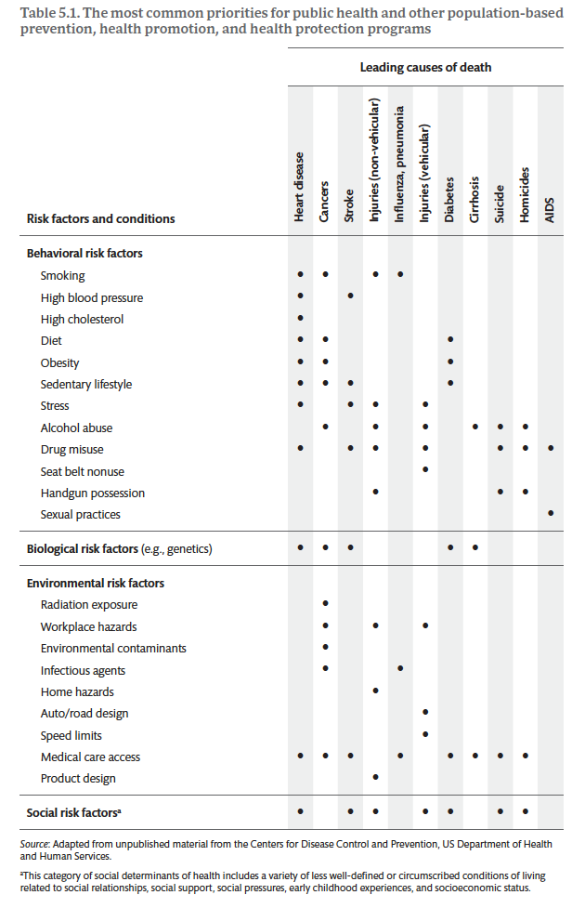

Slide 51
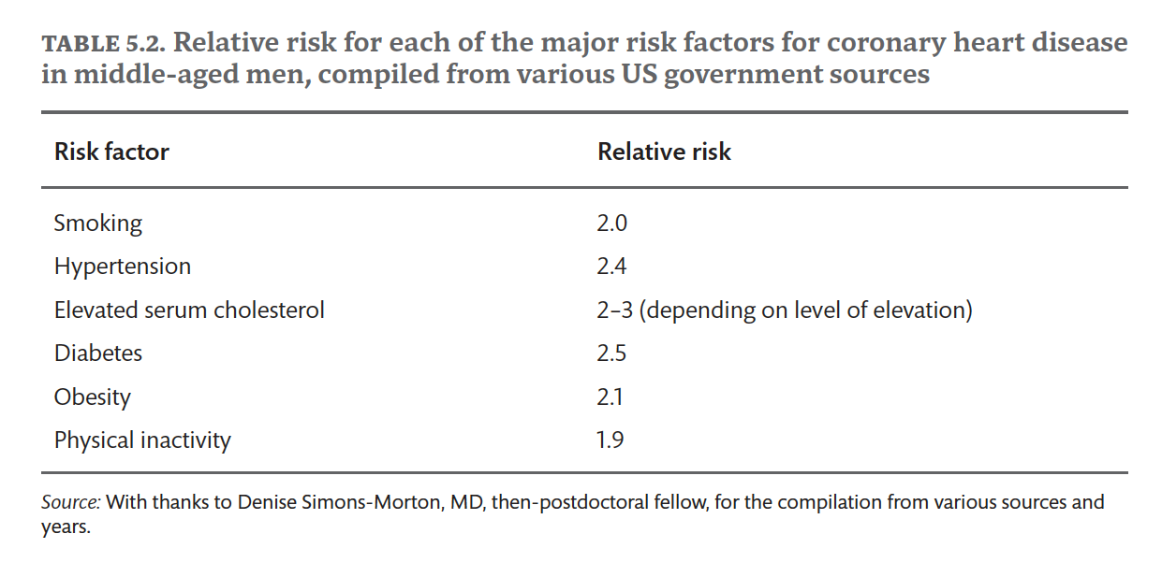

Slide 52
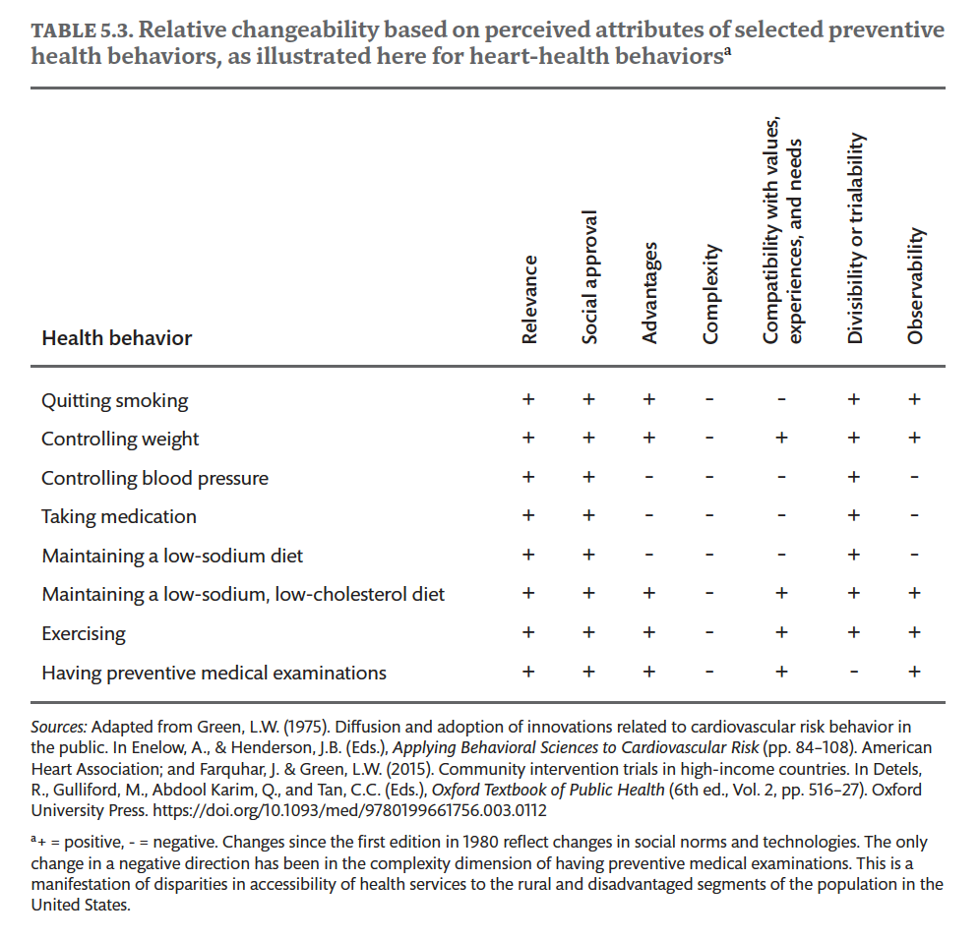

Slide 53
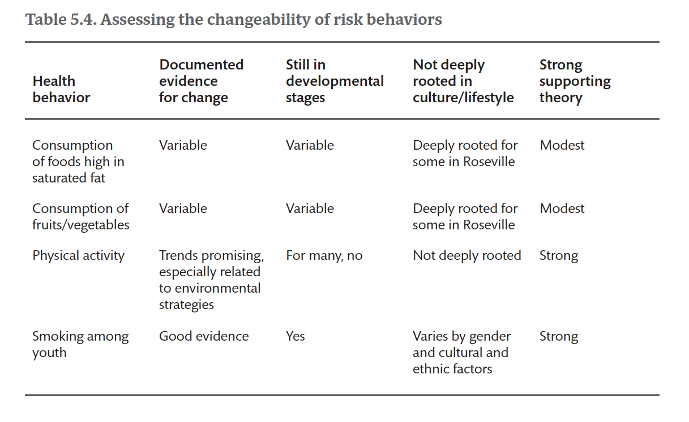

Slide 54
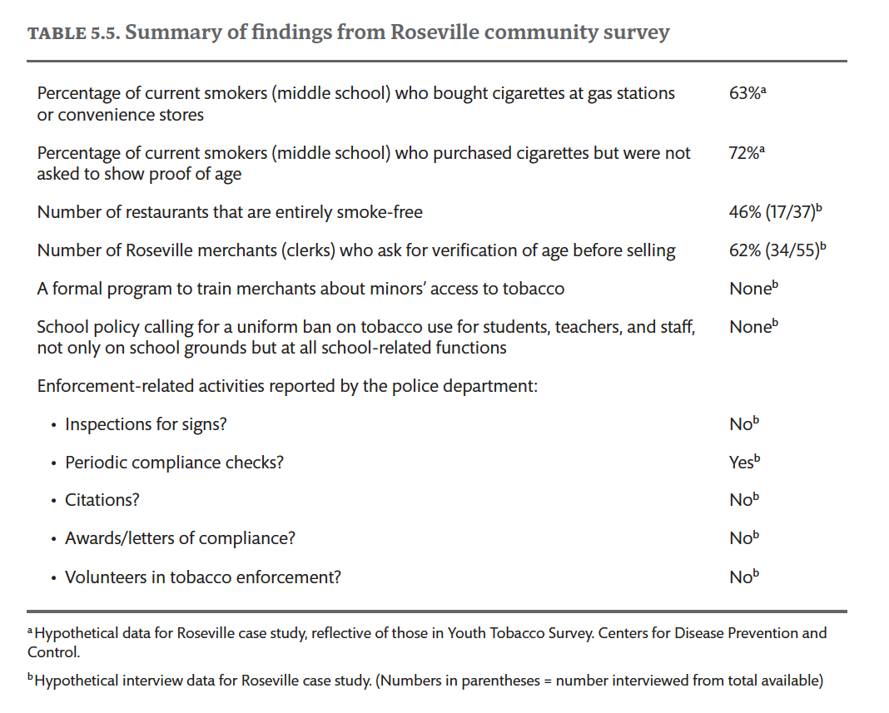

Slide 55
Chapter 5 Exercises
Identify behavioral and environmental factors associated with the health problem you chose for chapter 4’s exercises.
Rate (low, medium, high) each factor according to (a) its relative importance in affecting the health problem, and (b) its potential for change.
Discuss the reasons for your ratings.
Write an objective for both the highest-priority behavioral factor and the highest-priority environmental factor.

Slide 56
Chapter 6
Educational and Ecological Assessment: Predisposing, Enabling, and Reinforcing Factors
Green, Gielen, Ottoson, Peterson, and Kreuter, eds: Health Program Planning, Implementation, and Evaluation

Slide 57
Chapter 6 Learning Objectives
Describe the definitions and give examples of predisposing, reinforcing, and enabling factors influencing behavior and environmental conditions.
Explain how to use theory, evidence, and new data to identify predisposing, reinforcing, and enabling factors.
Describe and provide examples of how factors can interact to influence behavior and environmental conditions.
Provide examples of how you might engage a community in the identification and prioritization of predisposing, reinforcing, and enabling factors.
List and describe steps for considering which factors to prioritize in a health promotion planning effort.
Demonstrate an ability to distinguish and label types of factors influencing behavior and environmental conditions.

Slide 58
Figure 6.1
FIGURE 6.1. The third phase of the PRECEDE-PROCEED model, educational and ecological assessment, focuses on the predisposing, enabling, and reinforcing determinants of behavior and the environment.

Slide 59
Figure 6.2
FIGURE 6.2. Examples of predisposing, enabling, and reinforcing factors influencing behavior.

Slide 60
Figure 6.3
FIGURE 6.3. Predisposing, enabling, and reinforcing factors that influence the behavior of HPV vaccine uptake.

Slide 61
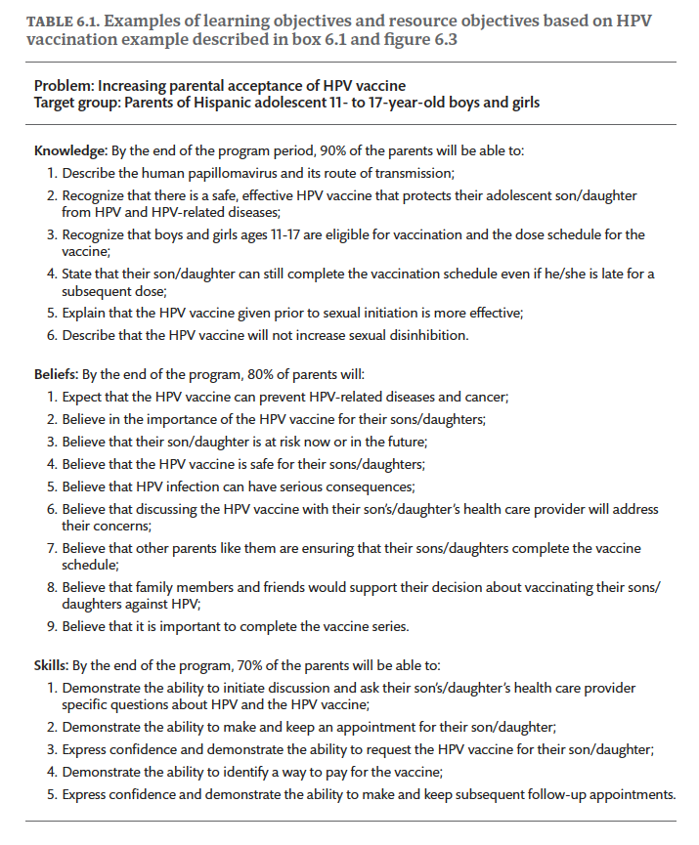

Slide 62
Chapter 6 Exercises
For one of the high- priority behavioral changes you selected in the previous chapter, list all the predisposing, enabling, and reinforcing factors you can identify. For a priority environmental condition, list the enabling factors.
Rate each factor believed to cause the health behavior or environmental condition according to its importance and changeability. Give each factor a rating of low, medium, or high on each criterion.
Write learning or resource objectives for the highest- priority predisposing factor, enabling factor, and reinforcing factor.

Slide 63
CHAPTER 7
Health Program and Policy Development I: Intervention Strategies
Green, Gielen, Ottoson, Peterson, and Kreuter, eds: Health Program Planning, Implementation, and Evaluation

Slide 64
Chapter 7 Learning Objectives
Match possible intervention strategies to the various ecological levels for intervention and to specific predisposing, enabling, and reinforcing factors.
Use “best practices” where available from the research literature and “best experiences” from other programs to address the most important predisposing, enabling, and reinforcing factors.
Adapt evidence- based strategies with practice- based evidence, observations, and experience of and for the particular population and context.
Use behavioral and social science theories to design new interventions specific to a population and context.
Pool and blend interventions into comprehensive programs that address the essential predisposing, enabling, and reinforcing factors identified in the previous chapter.
Create a logic model or theory of change to ensure a successful transition from planning to the implementation of practical strategies that lead to health improvements and to evaluation of them.

Slide 65
Figure 7.1
FIGURE 7.1. The fourth phase of the PRECEDE-PROCEED model, health program and policy development, begins with a focus on the identification and formation of, and priorities among, intervention strategies to influence determinants of behavioral and environmental change.

Slide 66
Figure 7.2
FIGURE 7.2. Sample material from the Smoke-Free Homes: Some Things are Better Outside program. Source: Emory Prevention Research Center, Rollins School of Public Health, Emory University.

Slide 67
Figure 7.3
FIGURE 7.3. Logic Model for Multi-Level Healthy Eating and Obesity Prevention Program

Slide 68
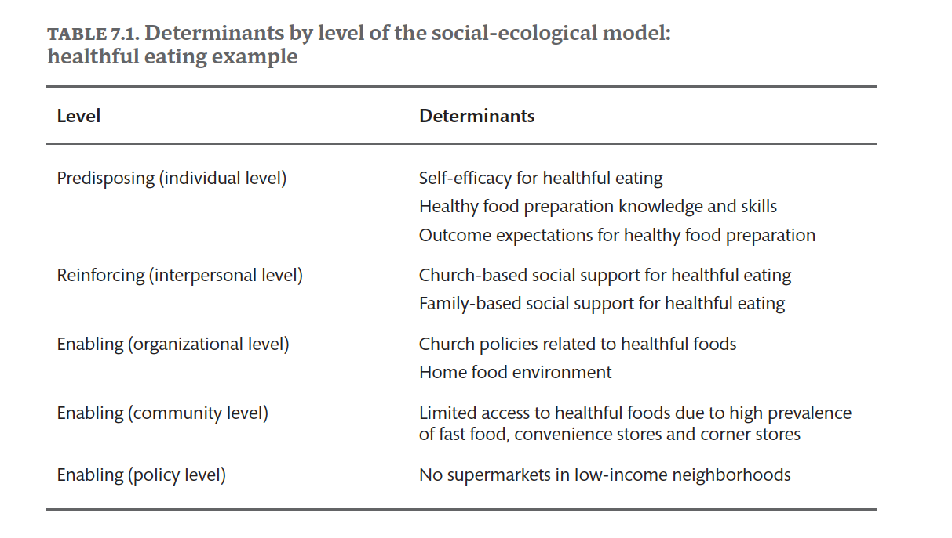

Slide 69
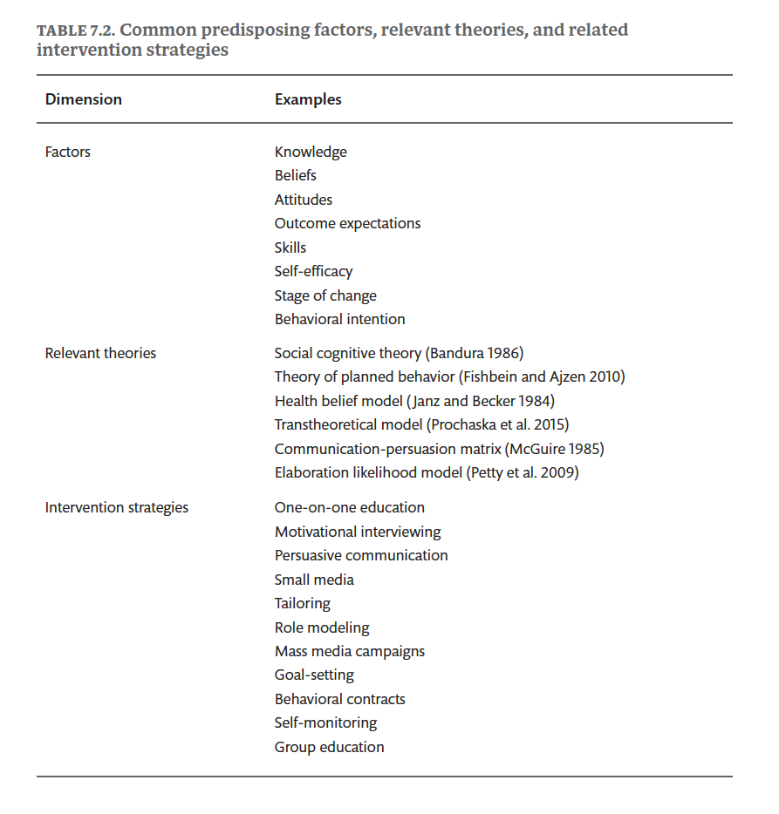

Slide 70
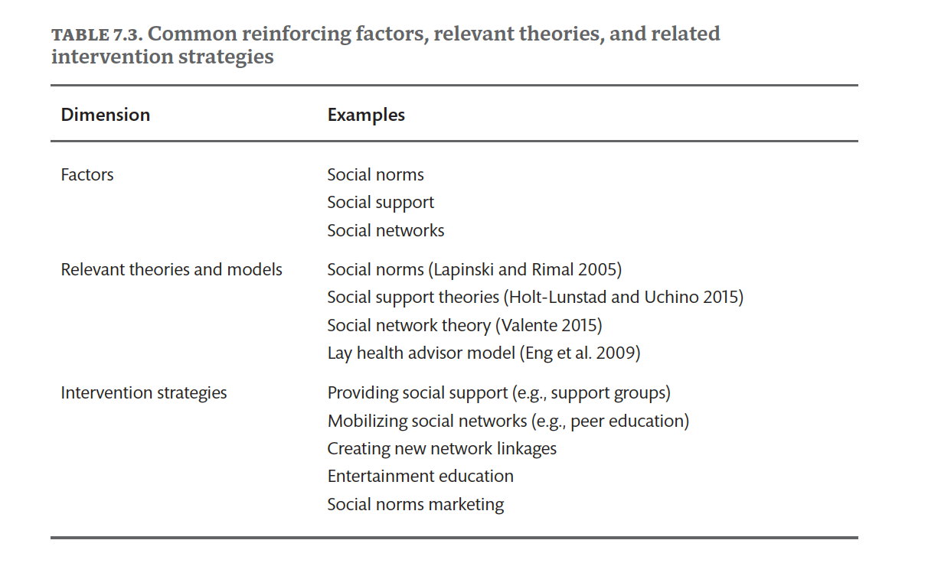

Slide 71
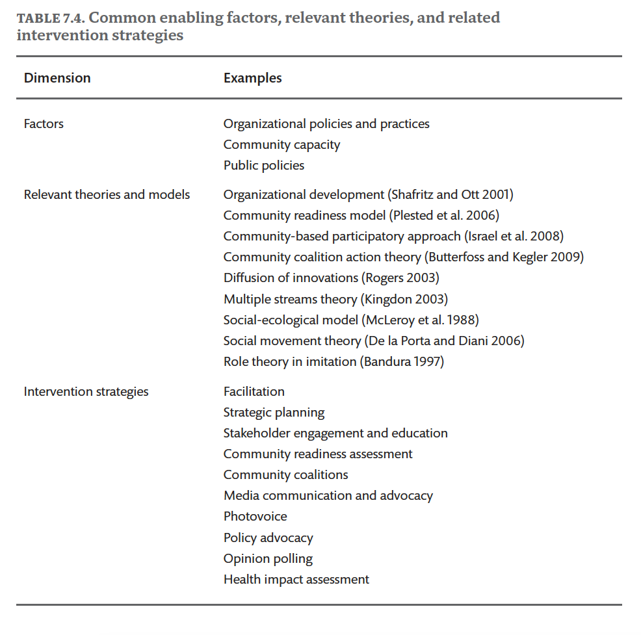

Slide 72
Chapter 7 Exercises
Build a comprehensive program strategy by creating intervention activities addressing each of the learning or resource objectives you wrote for Phase 3 (Chapter 6).
Diagram this strategy by creating a logic model linking inputs, activities, and outcomes as illustrated in Figure 7.3.

Slide 73
CHAPTER 8
Health Program and Policy Development II: Implementation Strategies
Green, Gielen, Ottoson, Peterson, and Kreuter, eds: Health Program Planning, Implementation, and Evaluation

Slide 74
Chapter 8 Learning Objectives
Understand the concept of implementation.
Discuss how implementation tools can assist with program delivery.
Describe factors relating implementation to planning and evaluation.
Describe phases of implementation.

Slide 75
Figure 8.1
FIGURE 8.1. The fourth phase of the PRECEDE-PROCEED model, health program and policy development, continues with the identification, formation, and initiation of priorities among implementation strategies to influence determinants of behavioral and environmental change.

Slide 76
Figure 8.2
FIGURE 8.2. Stages of Program Implementation (Following Program Planning)
Source: Fixsen, D.L., Naoom, S.F., Blase, K.A., Friedman, R.M., & Wallace, F. (2005). Implementation Research: A Synthesis of the Literature. University of South Florida, Louis de la Parte Florida Mental Health Institute.

Slide 77
Figure 8.3
FIGURE 8.3. Chronic Disease Self-Management Program GANTT Chart

Slide 78
Figure 8.4
FIGURE 8.4. Types of implementation outcomes. Source: Adapted from Proctor et al. (2011).

Slide 79
Figure 8.5
FIGURE 8.5. Pipeline to evidence-based practice. Source: Adapted from Green (2008).

Slide 80
Figure 8.6
FIGURE 8.6. Translation pipeline. Source: Adapted from IOM (2009).

Slide 81
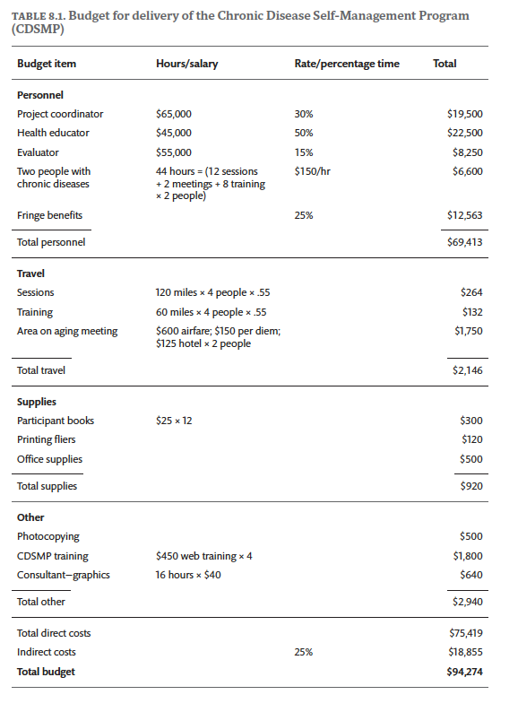

Slide 82
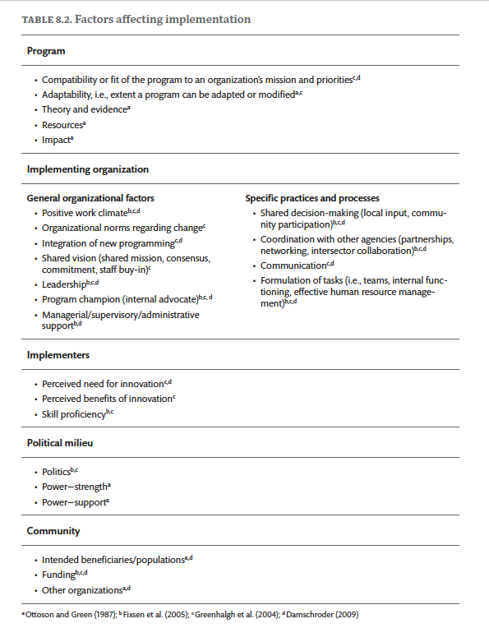

Slide 83
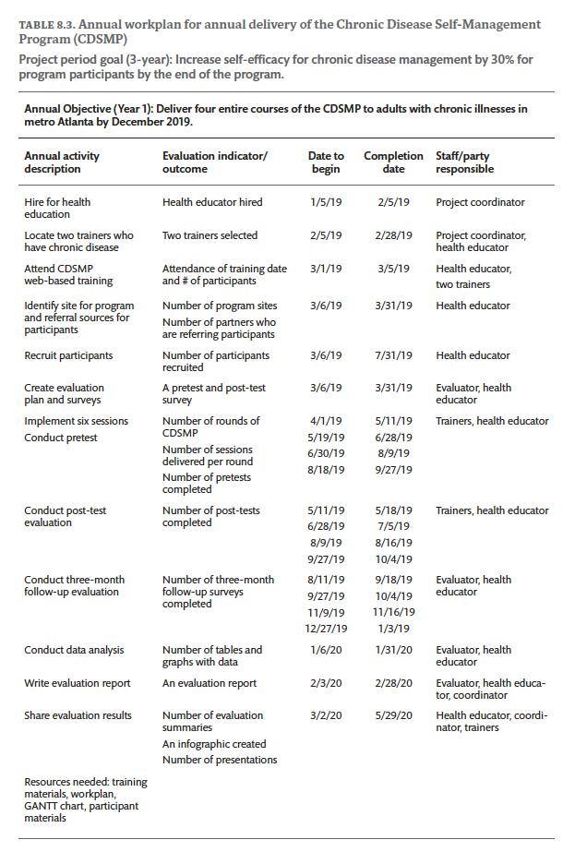

Slide 84
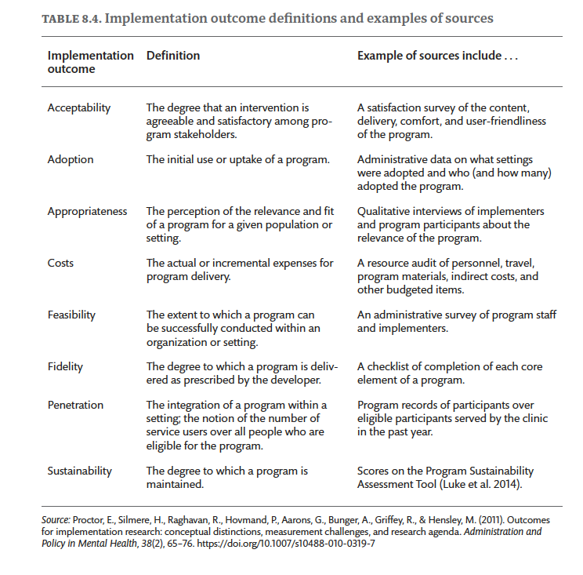

Slide 85
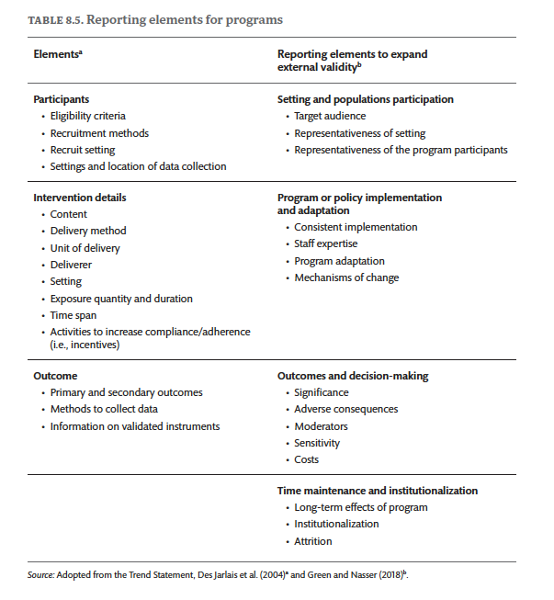

Slide 86
Chapter 8 Exercises
Identify the resources required for your program and develop a program budget.
Analyze what factors may affect the implementation of your program as facilitators and barriers. Develop potential solutions to the implementation barriers.
Develop a detailed work plan for a specific program that you are about to implement.
Describe the approaches your program might take to ensure its sustainability beyond the initial funding cycle.
Describe some implementation outcomes, in addition to health outcomes, that will be important to measure for your program.

Slide 87
CHAPTER 9
Health Program and Policy Development III:
Evaluation Strategies
Green, Gielen, Ottoson, Peterson, and Kreuter, eds: Health Program Planning, Implementation, and Evaluation

Slide 88
Chapter 9 Learning Objectives
Define program evaluation, including the different types of evaluation and how they are used.
Explain how the PRECEDE-PROCEED model integrates with the US Centers for Disease Control and Prevention (CDC)’s Framework for Program Evaluation in Public Health.
Describe the steps involved in conducting an evaluation and how the widely adopted “Evaluation Standards” are applied to each step of the process.
Identify key resources that you can use to support program evaluation.

Slide 89
Figure 9.1
FIGURE 9.1. The fourth phase of the PRECEDE-PROCEED model, health program and policy development, continues with the identification, formation, and initiation of priorities among evaluation strategies. Evaluation continues in Phases 5–8 to assess whether and how program or policy interventions were implemented as intended and set in motion changes that ultimately affect health and quality of life

Slide 90
Figure 9.2
FIGURE 9.2. Framework for program evaluation in public health. Source: Adapted from Centers for Disease Control and Prevention (2017).

Slide 91
Figure 9.3
FIGURE 9.3. PRECEDE-PROCEED Phases aligned with Evaluation Steps

Slide 92
Figure 9.4
FIGURE 9.4. Generic logic model. Source: Adapted from W.F. Kellogg Foundation. (2004). Logic Model Development Guide. https://www.wkkf.org/resource-directory/resources/2004/01/logic-model-development-guide

Slide 93
Figure 9.5
FIGURE 9.5. Layers of examples of evaluation questions. Source: Adapted from W.F. Kellogg Foundation. (2004). Logic Model Development Guide. https://www.wkkf.org/resource-directory/resources/2004/01/logic-model-development -guide

Slide 94
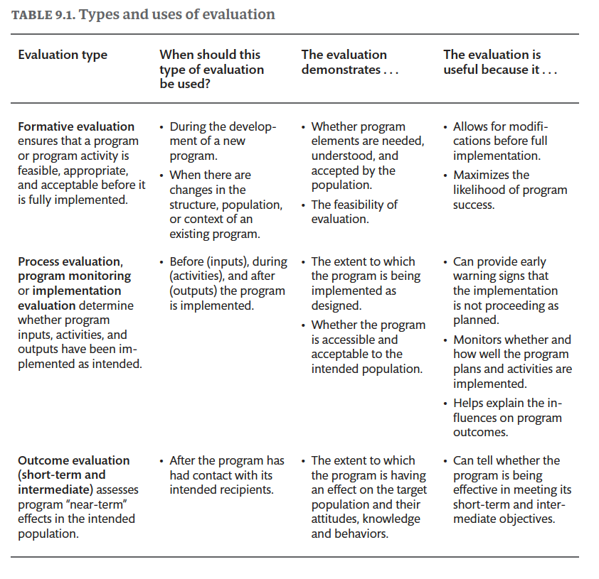

Slide 95
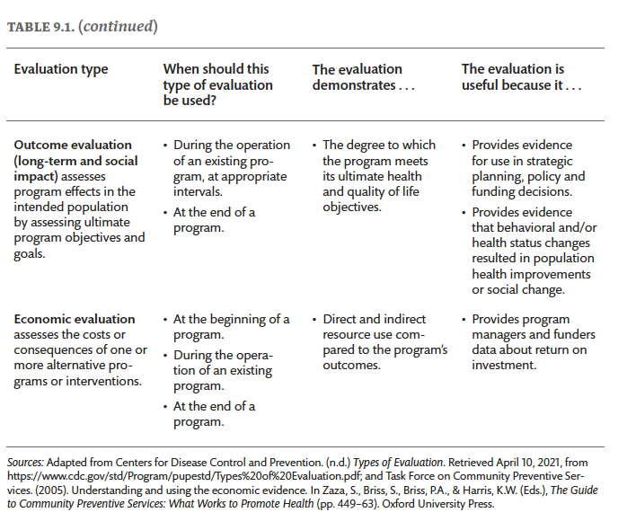

Slide 96
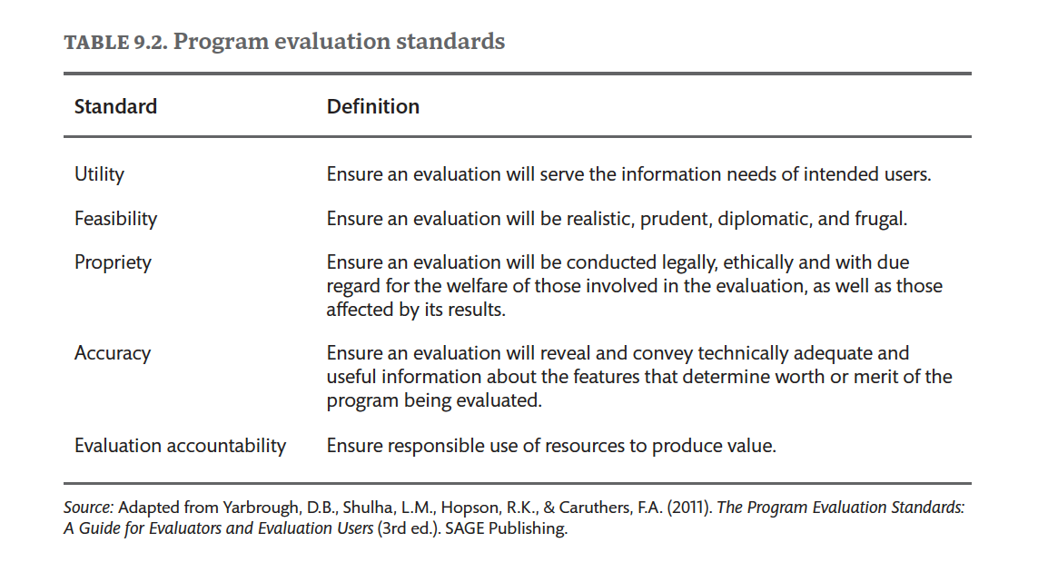

Slide 97
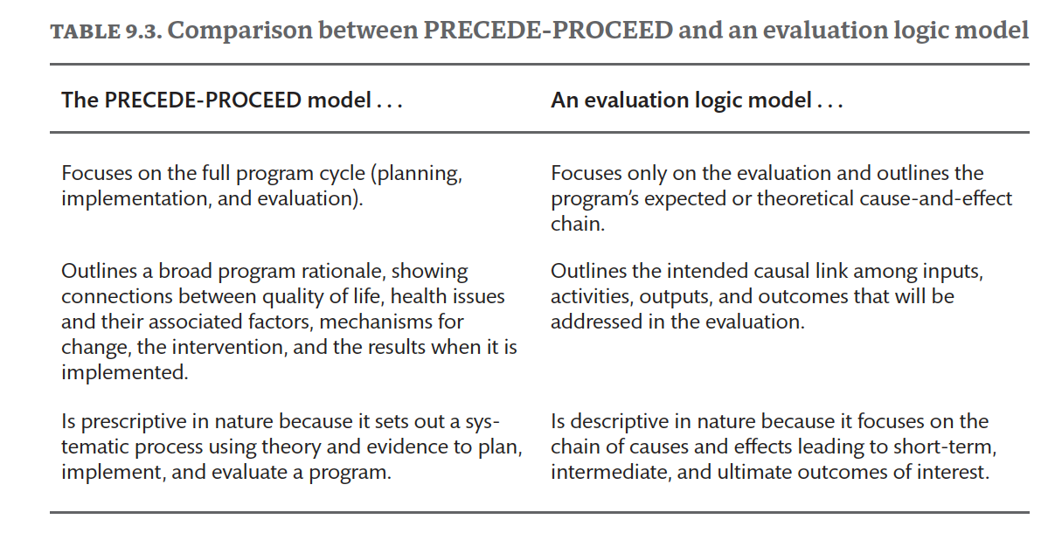

Slide 98
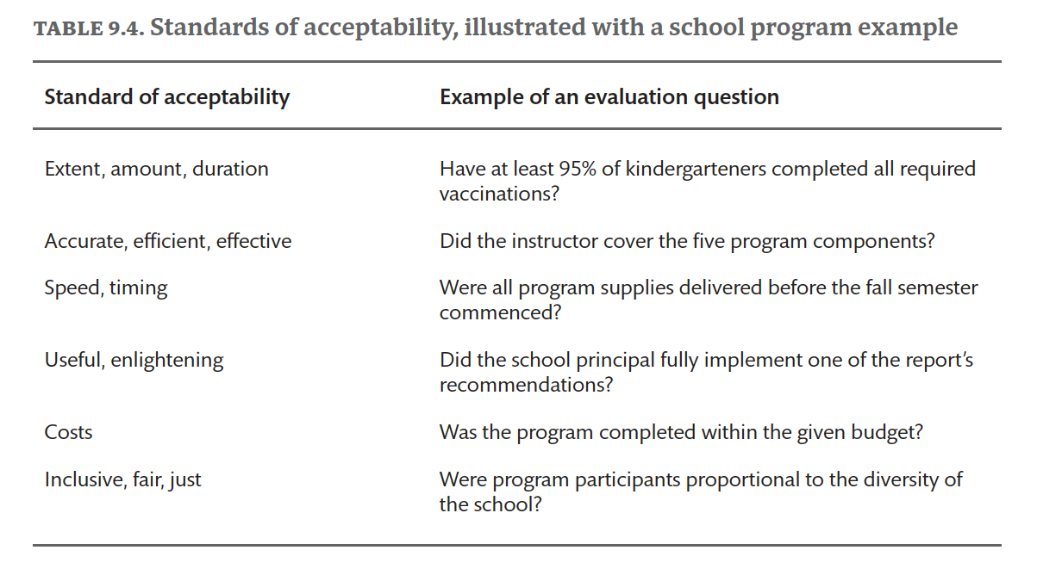

Slide 99
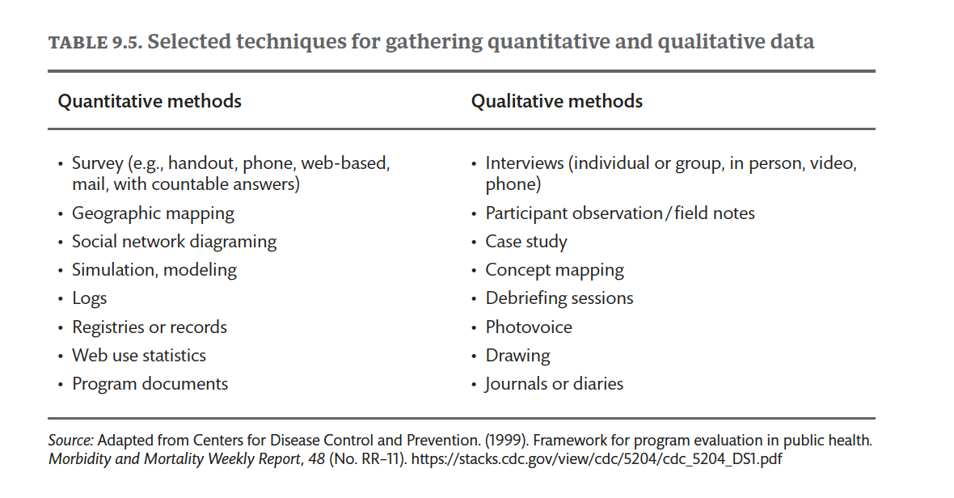

Slide 100
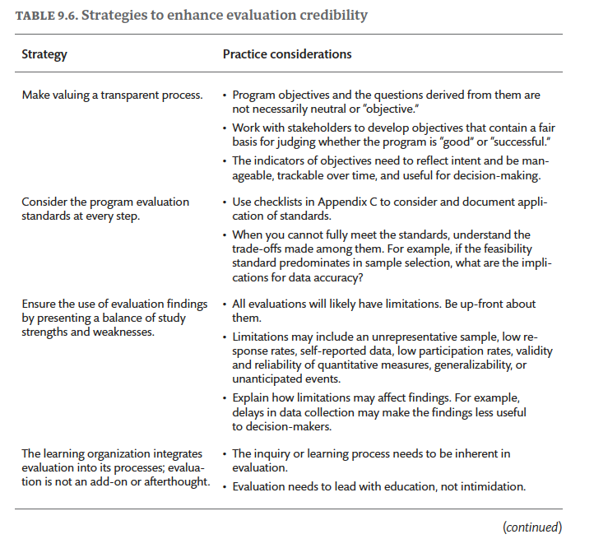

Slide 101
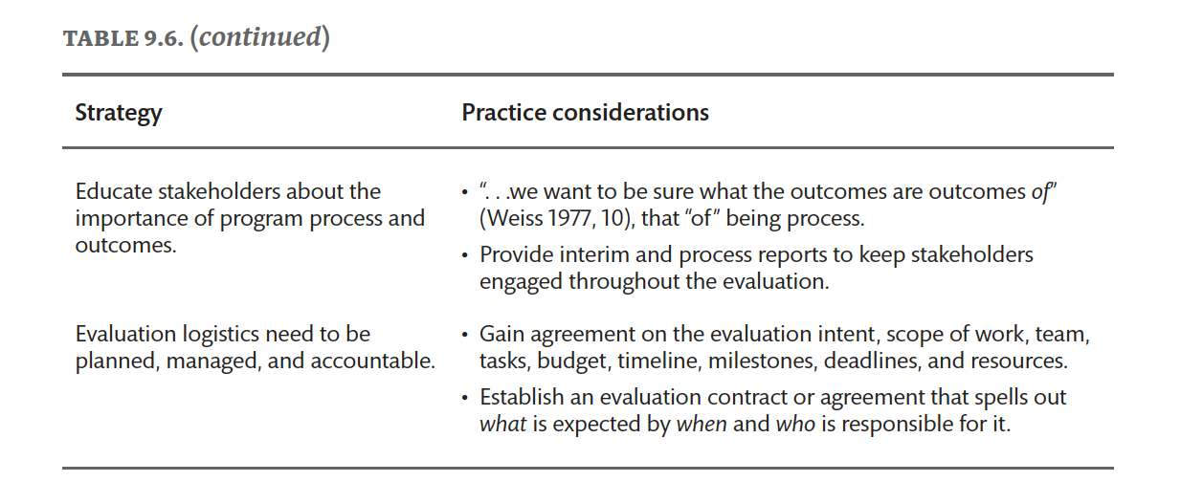

Slide 102
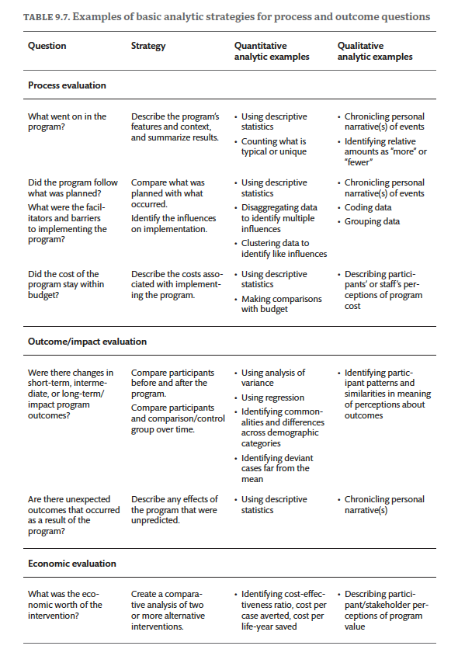

Slide 103
Chapter 9 Exercises
Retrieve one program objective from PRECEDE-PROCEED Phase 1 and Phase 2 and three educational or ecological objectives from Phase 3. For each objective, identify an object of interest and two different standards of acceptability; explain the strengths and weaknesses of each standard.
Using a case example from a previous chapter or in one of the several chapters on applications in specific settings and populations that follow, explain what design you would use to answer questions posed by stakeholders and describe the methods you would use to collect data.
Using the checklist in Appendix C, provide a short answer for the ways in which each of the standards will be applied to the chosen case example for each of the six steps in the evaluation process.

Slide 104
Part III
Applications of PRECEDE-PROCEED in Specific Settings
Green, Gielen, Ottoson, Peterson, and Kreuter, eds: Health Program Planning, Implementation, and Evaluation
Each of the following chapters provides an in-depth application of the PRECEDE-PROCEED model as it was named, visualized, and understood in the 4th edition.
This 5th edition of the model has the same 8 phases with expanded explanations and some name changes.
Don’t get lost in translation; Focus on the concepts; Get inspired!

Slide 105
CHAPTER 10
Applications in Community Settings
Green, Gielen, Ottoson, Peterson, and Kreuter, eds: Health Program Planning, Implementation, and Evaluation

Slide 106
Chapter 10 Learning Objectives
Understand that definitions of community in this context go beyond geography and recognize the term as identifying a group that shares not only distinctive characteristics, including special needs, but also laws, interests, norms, and values.
Recognize how diverse racial, ethnic, physical, social, economic, and cultural characteristics affect community health and how the community’s organization and the behaviors of the individual members shape it.
Identify ways that the PRECEDE- PROCEED model has helped communities participate in health intervention planning and implementation and document and evaluate health outcomes.
Become aware of and be prepared for the problems confronted by community health specialists in implementing the model and how they were resolved.

Slide 107
Figure 10.1
FIGURE 10.1. Factors in health outcomes. Source: County Health Rankings & Roadmaps. (2020). County Health Rankings Model. The University of Wisconsin Population Health Institute. http://www.countyhealthrankings.org

Slide 108
Figure 10.2
FIGURE 10.2. Process evaluation in communities. Process evaluation is initiated during early implementation and before impact evaluation. Evaluation helps those conducting interventions in communities prevent harm and reduce risks, along with other safety measures, and answers questions about meeting trial benchmarks. Careful monitoring and evaluation (observation, surveys, and key interviews) will answer important questions and identify predisposing, reinforcing, and enabling factors that affect behavior and social change in the community. Potential factors are listed here. Illustration by Beth Allen.

Slide 109
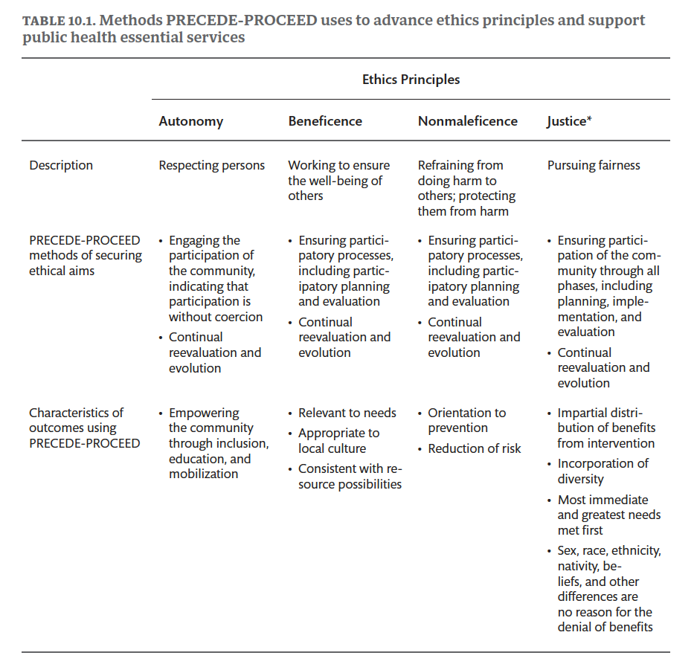

Slide 110
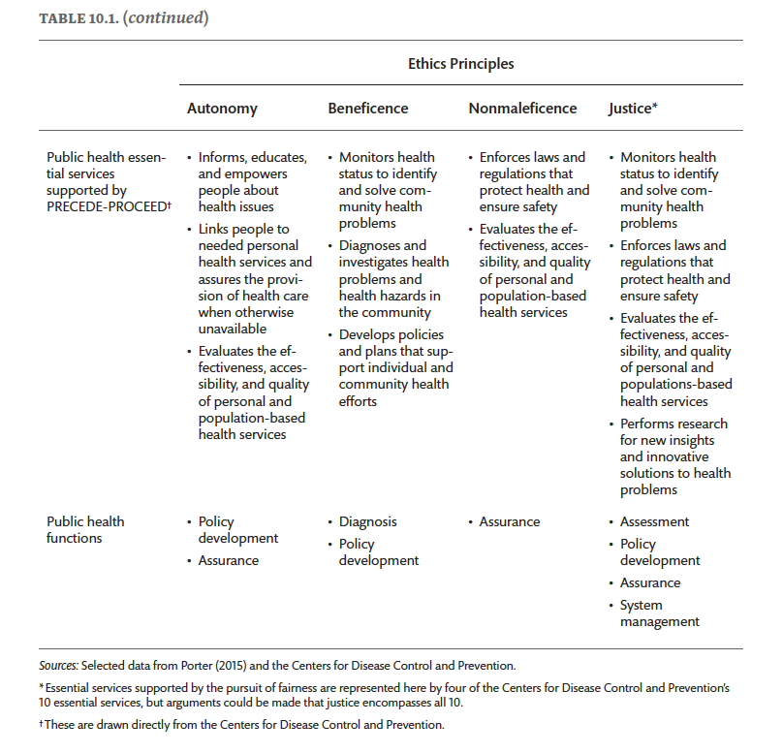

Slide 111
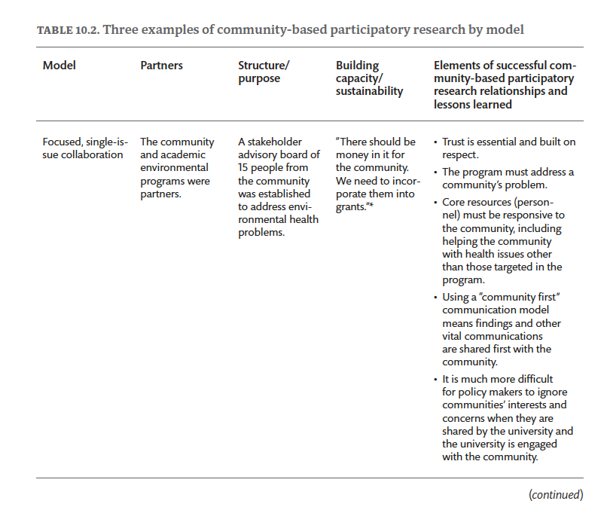

Slide 112
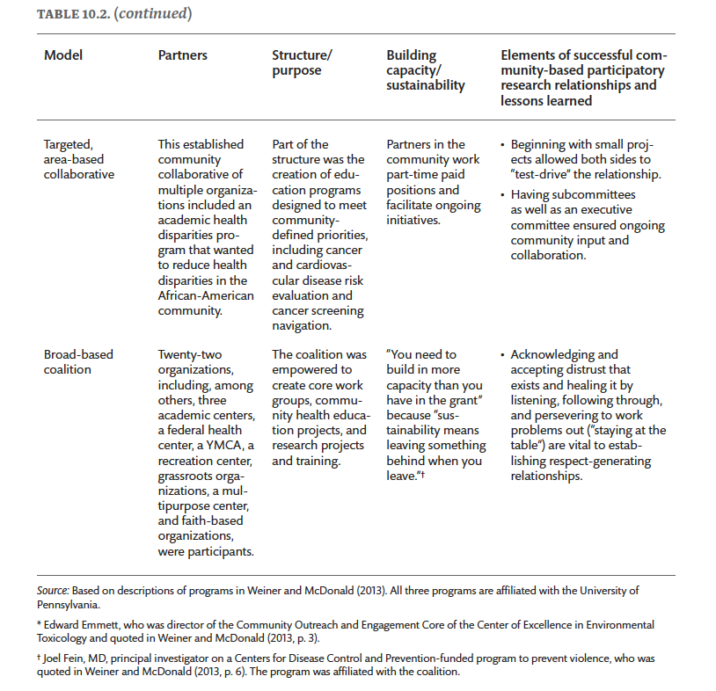

Slide 113
Chapter 10 Exercises – Introduction
Think about a specific health problem you would like to address in a community setting (i.e., school, neighborhood, or ethnic group)—for example, childhood obesity in a mostly Latino low-income neighborhood.
Residents in this neighborhood work mostly in construction, landscaping activities, and housekeeping. They have limited access to healthful foods with only one grocery store within five miles; there are multiple fast-food restaurants, and several are located within one mile of the school area.
Families have limited access to active spaces (trails, parks, and recreation facilities), and the neighborhood has safety issues with broken street lights, street dogs, and reports of gang-related activities.
Based on this description, construct the PRECEDE- PROCEED model diagram and detail your observations or assumptions about the first four phases.

Slide 114
Chapter 10 Exercises – Phases 1 and 2, identify intervention goal and objectives
Describe the demographic characteristics of the community and identify the key stakeholders to be involved in your plan to address this community health problem— for example, teachers, parents, or church leaders (Phase 1— Social Assessment).
Select five key stakeholders to be part of your Community Advisory Committee (CAC) to guide the intervention you would like to implement, and briefly describe why you selected them (Phase 1).
Describe the strategies to conduct a community needs assessment and identify community priorities (i.e., focus groups, key informant interviews, and key topics to include) (Phase 1).
Review the literature and draft a one- page summary of the epidemiology of childhood obesity in Latinos to present to the CAC (i.e., childhood obesity- related morbidity and mortality and the behavioral and socio- environmental risk factors that influence the health issue you want to address, which is, in this example, childhood obesity in a mostly Latino neighborhood) (Phase 2— Epidemiological Assessment).
To access data on this topic, please visit Salud America! It is a national network organized to promote Latino health equity and to perform research in healthy families and schools, healthy neighborhoods and communities, and healthy and cohesive cultures:
Healthy Families and Schools: https://salud-america.org/issues/healthy-families-schools/
Healthy Neighborhoods and Communities: https://salud-america.org /issues/healthy- neighborhoods-communities/
Healthy and Cohesive Cultures: https://salud-america.org/issues /healthy-cohesive- cultures/

Slide 115
Chapter 10 Exercises – Phases 3 and 4, plan and design intervention
List the predisposing (i.e., knowledge, attitudes, beliefs), reinforcing (i.e., influence of the social environment), and enabling (i.e., availability of resources, accessibility of services, state and local policies) factors affecting childhood obesity in this neighborhood (Phase 3— Behavioral and Environmental Assessment).
Think about what factors determine the feasibility of implementing the program to address childhood obesity in this neighborhood, including the resources available, associated organizations, and other invested stakeholders. Also, consider what national, state, and local policies or programs serve to lessen this health problem (i.e., community parks, farmers markets, community gardens, local schools’ food policies, fit programs sponsored by the Special Supplemental Nutrition Program for Women, Infants, and Children [WIC], and other initiatives) (Phase 4— Administrative and Policy Assessment).

Slide 116
CHAPTER 11
Applications in Occupational Settings
Green, Gielen, Ottoson, Peterson, and Kreuter, eds: Health Program Planning, Implementation, and Evaluation

Slide 117
Chapter 11 Learning Objectives
Integrate the PRECEDE- PROCEED model and data from health risk assessments, health care claims data, and organizational development surveys (i.e., employee satisfaction, engagement, and perceived organizational support) in workplace health program planning.
Describe the most effective strategies to engage workplace- based stakeholders (e.g., CEO, CFO, managers, employees, wellness champions) in the planning, implementation, and evaluation processes.
Identify evidence- based “best practices” in workplace health promotion and how best practices scorecards can be applied to advancing the planning and evaluation elements of the PRECEDE- PROCEED model.
Use tenets of the social- ecological framework to show how both the voice of the employee and the business case for workplace health improvement can be equally represented in program planning.
Explain how complex systems science complements the PRECEDE- PROCEED model when evaluating and implementing programs or policies in occupational settings.

Slide 118
Figure 11.1
FIGURE 11.1. The Social-Ecological Model, Source: Source: http://www.cdc.gov/violenceprevention/overview/social-ecologicalmodel.html

Slide 119
Figure 11.2
FIGURE 11.2. Stock and Flow Map created by the Georgia Health Policy Center to understand and prevent chronic disease. Source: Georgia Health Policy Center, Andrew Young School of Policy Studies. (n.d.) Systems Thinking. Georgia State University. https://ghpc.gsu.edu/tools-frameworks/systems-thinking/

Slide 120
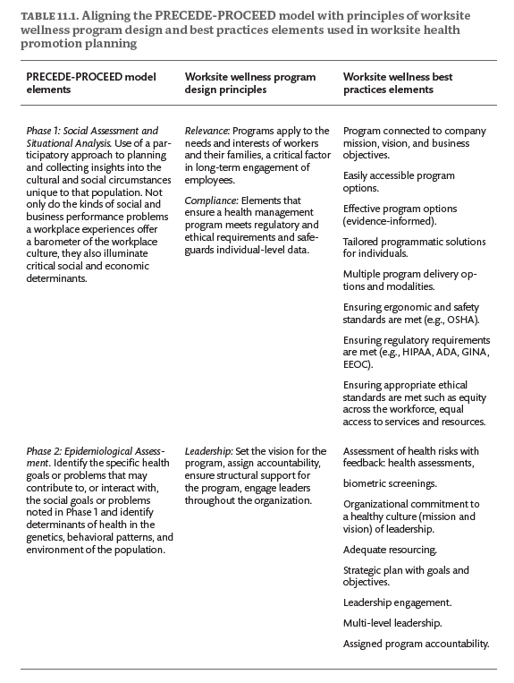

Slide 121
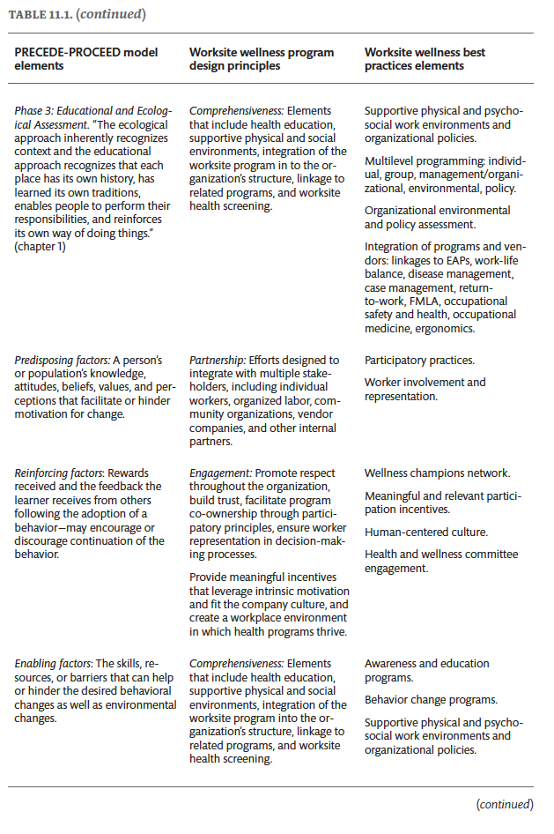

Slide 122
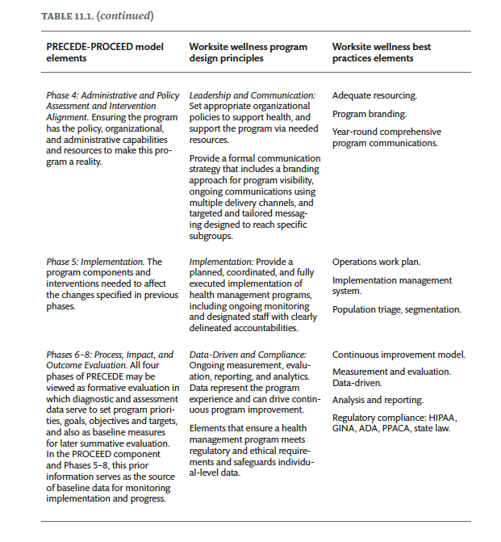

Slide 123
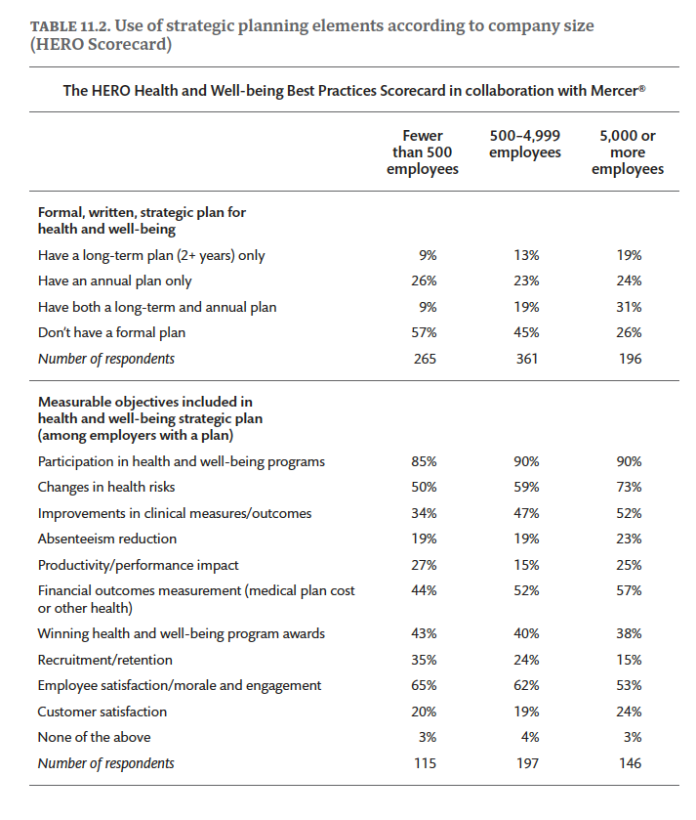

Slide 124
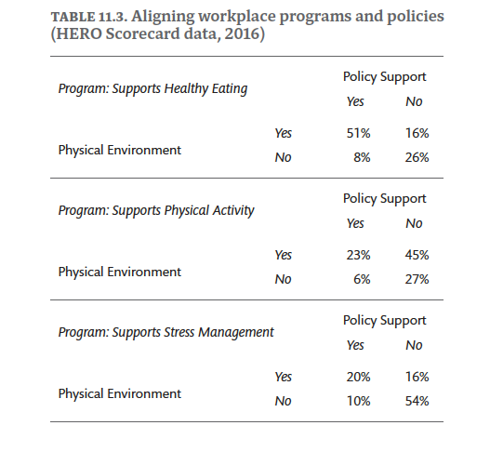

Slide 125
Chapter 11 Exercises
Much of the evolution of workplace-based health promotion derived from the business case for improving employee health was exemplified at DuPont. If you started over and wanted to build the employee case, how could the PRECEDE- PROCEED model support the case?
Lifestyle change and culture change are, of course, keenly interrelated. Name examples from workplace settings, such as at L.L. Bean, where individual health choices are profoundly mitigated, for good or for bad, by the environment.
Considering the health promotion planning and evaluation practices that led to the “Well at Dell” program at Dell, Inc., what elements of their case best advance the business case at the corporate executive level?
Considering the health promotion planning and evaluation practices that led to the MHealthy program at the University of Michigan, what components of their case best advance the employee’s case at the shop floor level?

Slide 126
CHAPTER 12
Applications in School Settings
Green, Gielen, Ottoson, Peterson, and Kreuter, eds: Health Program Planning, Implementation, and Evaluation

Slide 127
Chapter 12 Learning Objectives
Describe the modern school health program, its various components, and how health and education agencies together can plan, implement, and evaluate efforts to help schools improve both public health and education.
Identify and employ relevant public health surveillance systems to monitor efforts that can help schools measurably improve both public health and education.
Identify and employ available online resources that local, state, national, and international organizations can integrate to help schools improve both public health and education.

Slide 128
Figure 12.1
FIGURE 12.1. The Whole School, Whole Community, Whole Child (WSCC) Model: A Collaborative Approach to Learning and Health
Source: https://www.cdc.gov/healthyschools/wscc/index.htm

Slide 129
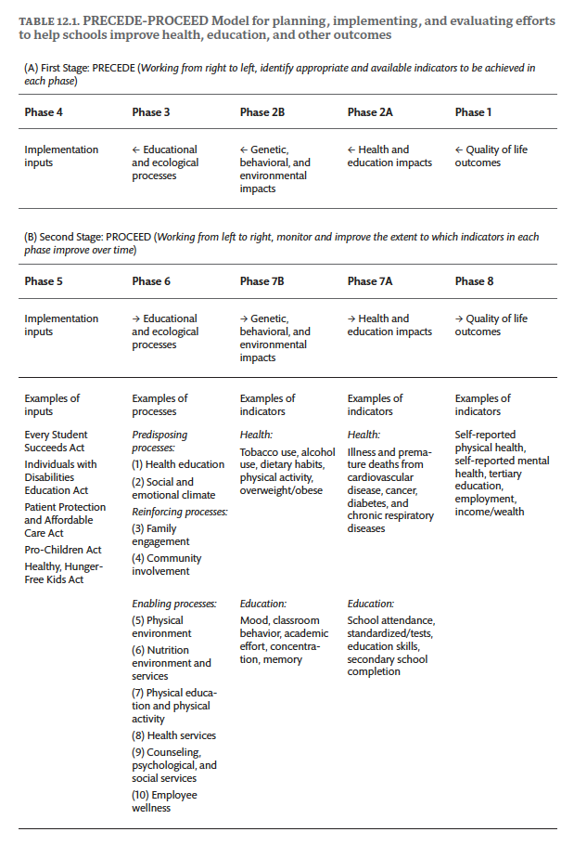

Slide 130
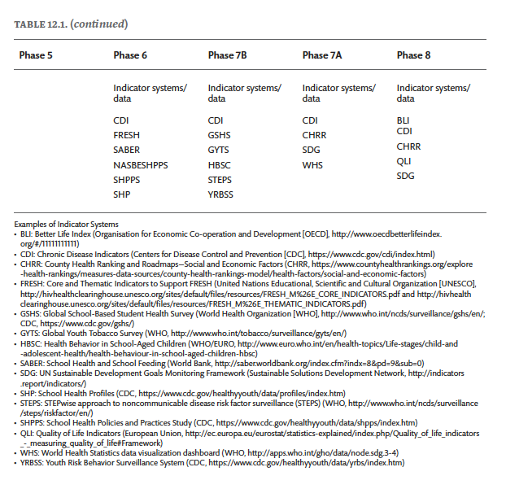

Slide 131
Chapter 12 Exercises – Complete one or more of the following
Select a jurisdiction for which you might plan, implement, and evaluate efforts to help schools in that jurisdiction improve specific health and education impacts: e.g., to prevent NCDs, HIV, other STDs, teen pregnancy, or other health problems. Identify for that jurisdiction: (a) an agency or agencies that might convene potential stakeholder organizations; (b) individuals in the convening agency or agencies who might delegate time and resources to help develop and implement the plan; (c) potential stakeholder organizations that might be convened to participate in the plan; (d) a rough and tentative timeline to pursue the planning, implementation, and evaluation processes; and (e) a rough agenda and materials that can be used for the first meeting of stakeholder organizations to be convened.
For the first meeting of stakeholder organizations to be convened for the jurisdiction, prepare a relatively brief background document that outlines the draft purposes, participants, and processes to be pursued at the first and subsequent meetings of interested stakeholder organizations.
For the first and subsequent meetings of interested organizations, prepare a relatively brief draft background document that interested stakeholder organizations can use to help them complete each of the following school health planning phases: Phases 1 and 8, Phases 2A and 7A, Phases 2B and 7B, Phases 3 and 6, and Phases 4 and 5. In the draft background document, identify potential indicators and information resources that stakeholders can use to help them complete each phase.

Slide 132
CHAPTER 13
Applications in Health Care Settings
Green, Gielen, Ottoson, Peterson, and Kreuter, eds: Health Program Planning, Implementation, and Evaluation

Slide 133
Chapter 13 Learning Objectives
Identify challenges and opportunities in the contemporary health care setting for using PRECEDE- PROCEED to improve the management of chronic diseases and infectious conditions.
Discuss the characteristics of the patient- centered, outcomes- oriented approach to health care and identify at least three key factors that can be exploited by health care providers to address issues of health behavior.
Provide specific examples of the application of PRECEDE-PROCEED as an effective planning framework for patient education in health care.
Describe the applications of the PRECEDE- PROCEED model to planning, implementation, and evaluation in the development of (a) a community awareness campaign designed to improve mental health literacy and encourage early help- seeking for mental health problems, and (b) an educational program designed to improve self- care behaviors, health outcomes, and quality of life in people with rheumatoid arthritis.

Slide 134
Figure 13.1
FIGURE 13.1. An interdisciplinary conceptual framework of clinicians’ compliance with evidence-based guidelines. Source: Gurses, A.P., Marstellar, J.A., Ant Ozok, A., Xiao, Y., Owens, S., & Pronovost, P.J. (2010). Using an interdisciplinary approach to identify factors that affect clinician’s compliance with evidence-based guidelines. Critical Care Medicine, 38(Suppl. 8), S282–91. https://doi.org/10.1097/CCM.0b013e3181e69e02

Slide 135
Figure 13.2
FIGURE 13.2. US National Health Expenditures as a Share of GDP, 1960–2021. Source: Centers for Medicare and Medicaid Services.

Slide 136
Figure 13.3
FIGURE 13.3. Application of the PRECEDE-PROCEED Model to The Compass Strategy. Source: Wright, A., McGorry, P.D., Harris, M.G., Jorm, A.F., & Pennell, K. (2006). Development and evaluation of a youth mental health community awareness campaign—The Compass Strategy. BMC Public Health, 6, 215. https://doi.org/10.1186/1471-2458-6-215

Slide 137
Figure 13.4
FIGURE 13.4. A summary of predisposing, enabling, and reinforcing factors (expressed as barriers) related to self-care behavioral outcomes, health outcomes, and quality of life outcomes in RA patients. Source: Nadrian, H., Morowatisharifabad, M.A., & Bahmanpour, K. (2011). Development of a rheumatoid arthritis education program using the PRECEDE-PROCEED Model. Health Promotion Perspectives, 1(2), 118–9. https://doi.org/10.5681/hpp
.2011.013. Reprinted with permission.

Slide 138
Chapter 13 Exercises
For any given clinical health care practice setting, identify and describe the distribution of chronic diseases or infectious conditions presented by patients and prioritize them for health education planning.
For the highest- priority chronic disease or infectious condition, identify what the literature on the clinical epidemiology of the disease suggests are the potentially modifiable behaviors of interest for behavioral self- management in this population of patients, and write a behavioral objective for the highest priority behavior.
Develop an inventory of the predisposing, enabling, and reinforcing factors for the highest- priority behavior, identify the priorities for each factor, and describe the educational objectives, intervention methods, and health outcomes of interest for evaluation to facilitate patient behavioral self- management of the disease or condition.
Develop a parallel set of objectives, intervention strategies, and health outcomes of interest for evaluation to facilitate health care provider behavior and the organizational or system changes necessary to facilitate patient behavioral self- management of the disease or condition.

Slide 139
CHAPTER 14
Applications in Communication Technology
Green, Gielen, Ottoson, Peterson, and Kreuter, eds: Health Program Planning, Implementation, and Evaluation

Slide 140
Chapter 14 Learning Objectives
Identify the contexts within which technology can play a role in applications of PRECEDE- PROCEED.
Discuss how principles of user-centered design, co-design, and participatory design align with hallmarks of the PRECEDE- PROCEED model.
Describe how PRECEDE- PROCEED elements have been used to develop a classification scheme to analyze health-related apps.

Slide 141
Figure 14.1
FIGURE 14.1. People-centered innovation overlaid on a map of design research. Source: Sanders (2008).

Slide 142
Figure 14.2
FIGURE 14.2. Schema for App Classification (2014). Source: Wang et al. (2014).

Slide 143
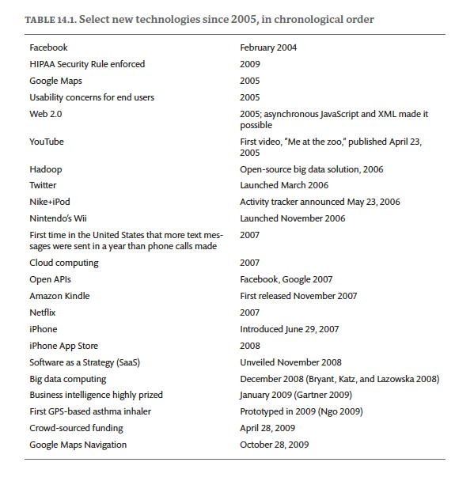

Slide 144
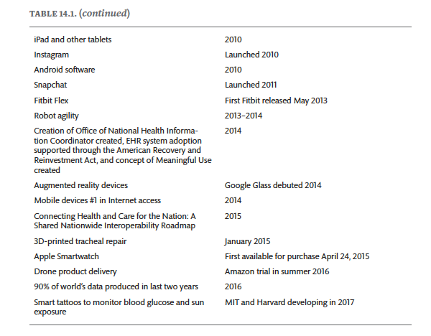

Slide 145
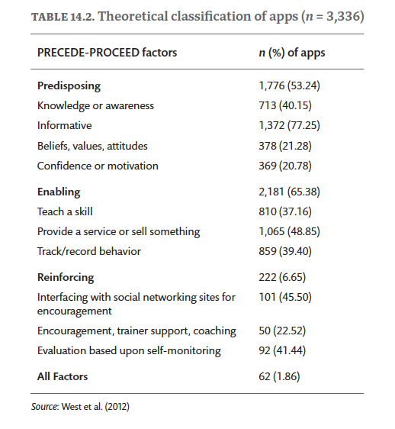

Slide 146
