Slide 1

Type 2 Translational Research Funding Programs
External Community Review Committee
Introduction for New Members
Maureen A Smith, MD MPH PhD
Associate Director
UW Institute for Clinical and Translational Research (ICTR)
Community-Academic Partnerships Core

Slide 2
Goals for this morning
Overview of the evolution to Type 2 Translational Research
Overview of the Institute of Clinical & Translational Research (ICTR) and the Community-Academic Partnerships Core

Slide 3
The NIH View:
The Continuum of Translational Research
Basic Research
Methods Development
Efficacy Trials
NIH Type 1
Translational Research
“Bench to bedside”
Publish

Slide 4
The NIH View:
The Continuum of Translational Research
Basic Research
Methods Development
Efficacy Trials
NIH Type 1
Translational Research
“Bench to bedside”
Publish
Effectiveness Research
Implementation Research
Policy Research
NIH Type 2
Translational Research
“Bedside to community”

Slide 5
What we know…and what we don’t
We know what to do
  Rigorous research on specific interventions
  Large body of evidence-based knowledge
We don’t know how to make sure that our knowledge isn’t applied or isn’t applied well
  Reasons for gap are poorly understood
  Lack widespread implementation of effective treatments

Slide 6
A Type 2 Translational Research question will…
Examine the gap between knowledge and practice
  Are known efficacious interventions used in community settings? Why or why not?
  Are they applicable in community settings? Why or why not?
Develop, evaluate, disseminate behavioral interventions to improve practice
  Change in individual behavior?
  Change in organizational behavior?
  Systems redesign?
Examine impact of policies or policy changes

Slide 7
Examples of past funded projects
Diabetes assessment and program implementation with schools & community organizations
Systems assessment of ICU and cardiac care
Obesity prevention program feasibility studies
Participatory photo mapping as community-engaged assessment tool to impact policy
Tobacco use, drug addiction and medication adherence with community-based organizations
Patient-centered and family-centered care assessments
Asthma medication adherence with pharmacists in rural settings
Screening and primary care for chronic diseases (chronic kidney disease, depression, colon cancer)

Slide 8
Background: UW Institute for Clinical &Translational Research (UW ICTR)
Institute for Clinical & Translational Research
  5 year funding from NIH
  Matching funds from UW and Wisconsin Partnership program
The goal of the UW ICTR is to create an environment to transform health-related research at the University
  a continuum extending from investigation through discovery to translation into practice
  linking research to real and measurable improvement in health

Slide 9
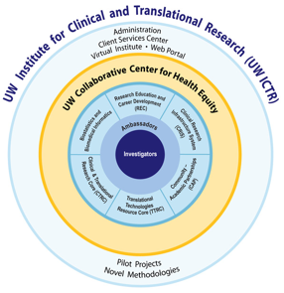
The ICTR Cores

Slide 10
UW ICTR Partnerships
Formal Partnerships
  School of Medicine and Public Health
  School of Nursing
  School of Pharmacy
  School of Veterinary Medicine
  College of Engineering
  Marshfield Clinic

Slide 11
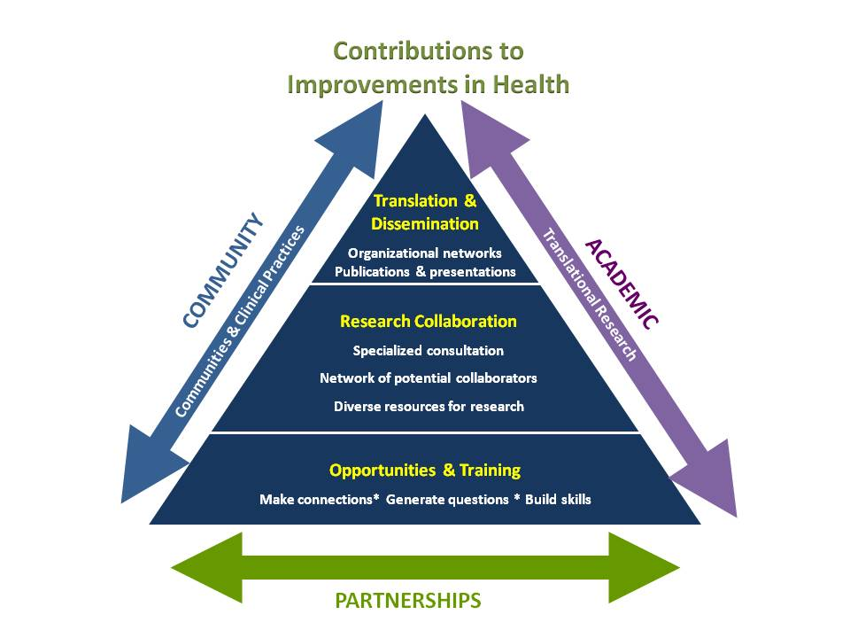
ICTR-Community Academic Partnerships Program (ICTR-CAP)
  Long-term goal: to support collaborative, multidisciplinary research that solves problems in translating new and existing knowledge into improvements in clinical practice, community health programs and policy.

Slide 12
ICTR-CAP Type 2 Translational Research Funding Programs
External Community Review Committee Scoring Session
Maureen A Smith, MD MPH PhD
Associate Director
UW Institute for Clinical and Translational Research (ICTR)
Community-Academic Partnerships Core

Slide 13
Goals for Today
Discuss and score Community Collaboration proposals (goal: fund up to 2)
Discuss and score Pilot proposals (goal: fund up to 7)

Slide 14
T2TR Program Goals
Pilot Program ($50,000 for 1 year)
To gather pilot data leading to future larger research projects that discover the best ways to translate new and existing findings into improvements in clinical practice and community health programs.
Community Collaboration Program ($200K for 2 years)
To support community-engaged research partnerships that solve problems in translating clinical and health-related scientific knowledge into meaningful changes into clinical practice or community health programs.

Slide 15
A Type 2 Translational Research question will…
Examine the gap between knowledge and practice
Develop, evaluate, disseminate behavioral interventions to improve practice
Examine impact of policies or policy changes

Slide 16
NIH definition of community
(as defined by NIH for PA-08-077, Community Participation in Research R01)
Community refers to target populations that may be defined by:
  geography
  race
  ethnicity
  gender
  sexual orientation
  disability, illness, or other health condition
or to groups that have a common interest or cause, such as
  health or service agencies and organizations
  health care or public health practitioners or providers
  policy makers
  or groups with public health concerns

Slide 17
NIH definition of community organizations
“Community-based organizations” refer to organizations that may be involved in the research process as members or representatives of the community. Possible community partners include, but are not limited to:
  Tribal governments & colleges
  state or local governments
  independent living centers
  other educational institutions such as junior colleges
  advocacy organizations
  health delivery organizations (e.g., clinics, hospitals, and networks)
  health professional associations
  non-governmental organizations
  Federally-qualified health centers

Slide 18
Community engagement criteria for pilots grants
  Applicants are asked to address:
  Who is the constituency or group that will benefit from research?
  Please describe how a representative of that community/constituency is involved in the research.

Slide 19
Community engagement criteria for
Community Collaboration grants
  Applicants are asked to address:
    Who is the constituency or group who will benefit from the research?
    When did collaboration begin and outline collaboration activities to date.
    How is this community/constituency, or a representative thereof, involved in the research; what is their role?
    Plans for sharing results of research with the “end-users” of research.
    Plans for sustained partnership including information about sustained funding to support this partnership.

Slide 20
The T2TR Grant Review Process
Technical Review
Scientific Review by three experienced researchers
ICTR-CAP Study Section Scoring
  Proposals sent forward to ECRC if scored up to or better than “minor scientific weaknesses”
External Community Review Committee makes final funding recommendations
  Discussion of process at the end of the meeting

Slide 21
Changes from previous ECRC
In addition to abstracts, ECRC packet now includes
  Section of the proposal that directly addressed the question “How will you engage the end users of your research?”
  Letters of support from community collaborators
New scoring paradigm based on NIH
ECRC scoresheet allows all scores to appear on one page for easier decision-making

Slide 22
Components of Scientific Review
Significance: Important problem?
Investigators: Well suited to conduct project?
Scientific Excellence & Approach: High scientific merit?
Innovation: New avenues of investigation?
Engagement of “end users” of research: Consider criteria for each grant program
Attention to special criteria: collaborations, NIH targeted projects, novel methodologies
Justification of type 2 translational research
Likelihood of leading to new peer-reviewed funding
Budget: Feasible?

Slide 23
NIH Scoring for Scientific Merit
Scores | Descriptor | Scientific Anchor
1 * | Exceptional | Exceptionally strong potential for impact; essentially no weaknesses
2 * | Outstanding | Extremely strong potential for impact with negligible weaknesses
3 * | Excellent | Very strong potential for impact with only some minor weaknesses
4 * | Very Good | Strong potential for impact with numerous minor weaknesses
5 | Good | Strong potential for impact but with at least one moderate weakness
6 | Satisfactory | Some potential for impact but hampered by moderate weaknesses
7 | Fair | Some potential for impact but hampered with at least one major weakness
8 | Marginal | Limited potential for impact and a few major weaknesses
9 | Poor | Limited potential for impact and numerous major weaknesses
* Proposals with highest scientific merit forwarded to ECRC

Slide 24
Impact Scoring Guide
Scores | Descriptor | Impact Anchors
1 | Exceptional | Exceptionally strong potential for impact in a highly significant area
2 | Outstanding | Extremely strong potential for impact in a highly significant area
3 | Excellent | Very strong potential for impact in a highly significant area
4 | Very Good | Strong potential for impact in a highly significant area
5 | Good | Strong potential for impact in a moderately significant area
6 | Satisfactory | Some potential for impact in a highly significant area
7 | Fair | Some potential for impact in a moderately significant area
8 | Marginal | Limited potential for impact in a highly significant area
9 | Poor | Limited potential for impact in a moderately significant area
Please use entire scoring range.

Slide 25
How to think about priorities
Significance: This research area addresses important problems or critical barriers to progress in advancing/improving clinical practice and/or community health. The project has long-term potential to contribute to the advancement of health.
Priority: The research area addressed by this proposal should be an investment priority for UW-Madison and Marshfield.
Community: This research project, based on the criteria for the specific grant program, effectively incorporates the input of community partners/end users.

Slide 26
Conflict of Interest
Do not score – write COI in the score box
  Reviewer has responsibility or involvement in the project or has advised or consulted on development
  Reviewer or family member has employer or investment relationship with PI or key personnel

Slide 27
TODAY
Proposal in binder separated by grant program
Maureen Smith will introduce each proposal
ECRC member discussion
ECRC scoring (or COI) after discussion of each proposal
Average of final scores will become the final score of the ECRC

Slide 28
Discussion of
Impact & Scientific Merit Scores

Slide 29
Your questions?

Slide 30
Your feedback
Your thoughts about this process have improved it every year.
What would you like to share to help us continue this trend?

